Slide 1
LearnPath+ Enhancing Personalized E-Learning: A Novel Approach to Adaptive Learning Pathways for Individualized Knowledge Acquisition
Project ID : R24-112

Slide 2

OUR TEAM
Supervisor
Ms. Sanjeevi Chandrasiri
Co-Supervisor
Miss Akshi De Silva
IT21033032
Nishshanka N.A.P.K.R
IT21021602
Abeykoon R.M.S.P
IT21032806
Jayasinghe K.A.K.N
IT21032974
Nishshanka N.A.G.A.A

Slide 3
OVERALL INTRODUCTION
Identifying limitations of current e-learning systems in delivering personalized learning.
Implementing an innovative framework based on adaptive machine learning.
Bridging the gap between generic content delivery and personalized learning pathways.
Adopting a user-centric approach integrating machine learning, educational tech, and user experience design.
Improving user engagement, knowledge retention, and satisfaction levels in e-learning.
Redefining how individuals interact with educational content in the digital age.
Notes:
In response to the limitations of current e-learning systems in delivering personalized learning experiences, our project aims to transform the landscape by implementing an innovative framework grounded in adaptive machine learning. Our goal is to bridge the gap between generic content delivery and tailored learning pathways through a user-centric approach that integrates machine learning, educational technology, and user experience design.
We aspire to improve user engagement, optimize knowledge retention, and elevate satisfaction levels across e-learning platforms. With this approach, we will redefine how individuals interact with educational content in the digital age, creating a learning experience that meets the unique needs of each user.

Slide 4

OVERALL RESEARCH PROBLEM
Lack of Personalization: E-learning platforms struggle to tailor personalized learning experiences to individual preferences and learning styles.
Generic Approaches: Current systems use content delivery methods that don't maximize user engagement or knowledge retention.
Limited Adaptability: Most platforms can't dynamically adjust to diverse learner needs, creating difficulties in accessing relevant materials.
Gap in Literature: There's a lack of research on developing adaptive machine learning models for customizing learning pathways in online education.
Notes:
Let's delve into the overall research problem. First, there's a significant lack of personalization across existing e-learning platforms. They struggle to deliver personalized learning experiences that fit individual preferences and learning styles. Current systems often rely on generic content delivery approaches that don't optimize user engagement or knowledge retention.
Additionally, many platforms have limited adaptability. This makes it challenging to dynamically adjust to individual learner needs, leaving many students struggling to find relevant content. Finally, there's a notable gap in the literature. There's a lack of research focused on straightforward adaptive machine learning models that can effectively customize learning pathways in online education. This gap is what our research aims to address.

Slide 5

OBJECTIVES
Main Objective:
Develop an innovative framework for personalized learning in e-learning platforms using adaptive machine learning.
Tailor educational content to individual users' preferences and learning styles.
Revolutionize online education delivery through adaptive machine learning techniques.
Enhance user engagement, optimize knowledge retention, and increase satisfaction levels.
Notes:
Our main objective with this project is to develop a cutting-edge framework for personalized learning in e-learning platforms by leveraging adaptive machine learning. This framework will transform how educational content is delivered by customizing the learning experience to each user's unique preferences and learning style. By employing adaptive machine learning techniques, we aim to boost user engagement, improve knowledge retention, and ultimately, elevate satisfaction levels in online education. Our goal is to revolutionize the field, offering students a more tailored, effective, and rewarding learning journey.

Slide 6
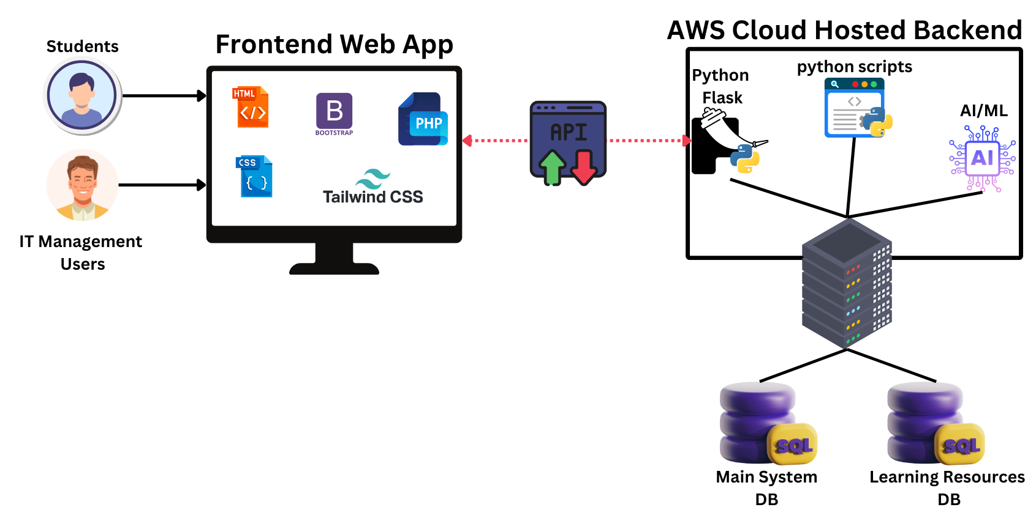
OVERALL SYSTEM DIAGRAM
Notes:
Users 2 – student/IT
Front – html/css/php/js
Backend – AWS
Pyhton flask server (simple http server)

Slide 7

IT21033032 | Nishshanka N.A.P.K.R
Objective : Implementing Student Learning Profiling module for better user profile analysis.
Specialization: Information Technology
IT21033032 | Nishshanka N.A.P.K.R | R24-112

Slide 8
INTRODUCTION
IT21033032 | Nishshanka N.A.P.K.R | R24-112

Slide 9

RESEARCH PROBLEM
How can user data, including learning preferences, past performance, and preferred learning styles, be effectively gathered and analyzed to create personalized profiles?
How do different factors within user profiles interact to influence the effectiveness of personalized learning experiences?
What are the privacy and ethical considerations associated with collecting and utilizing user data for personalized e-learning?
How to integrate OpenAi or GeminiAi for user profiling of LMS?
IT21033032 | Nishshanka N.A.P.K.R | R24-112

Slide 10

SPECIFIC AND SUB OBJECTIVES
Finalize the initial user dataset which need to gather from student.
Implementing a python-based backend module for evaluate the initial student data and give the initial user profiling.
Implementing a python-based backend module for evaluate the both of data initial and dynamic and give the weekly user profiling.
Ingenerate OpenAI or Gemini AI for make the output of final weekly student user profiling part as AIML integration.
Implementing the MySQL database configuration related to the user profiling part.
Implementing the all-relevant frontend pages related to the user profiling module.
IT21033032 | Nishshanka N.A.P.K.R | R24-112

Slide 11
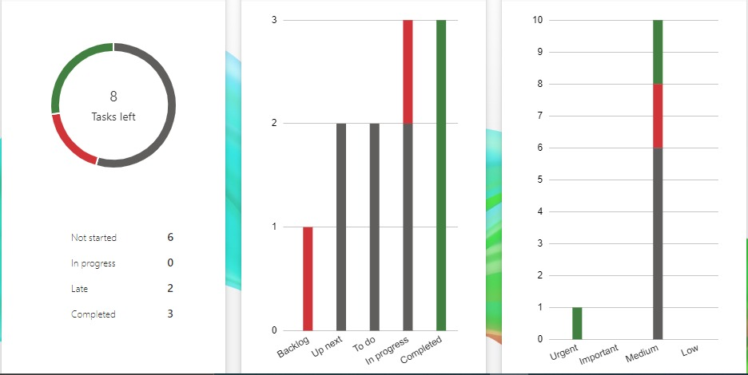
COMPLETED TASKS
Complete background research about other LMS platforms and their data usage.
Finalize the initial dataset which need to make the initial user profiling part.
Implement a sample python code for perform the initial user profiling (exam results-based part).
Identify and finalize the technology stack and backend configurations and database configurations for overall system.
Learn about the relate technologies (system engineering terms) for how to setup this kind of system in real world.
Partially implement a webpages related to the component.
IT21033032 | Nishshanka N.A.P.K.R | R24-112

Slide 12
IN PROGRESS TASKS
Implementing a python-based backend module for evaluate the initial student data and give the initial user profiling.
Implementing a python-based backend module for evaluate the both of data initial and dynamic and give the weekly user profiling.
Implementing the MySQL database configuration related to the user profiling part.
Learn about more AIML technologies for implement the AIML module.
IT21033032 | Nishshanka N.A.P.K.R | R24-112

Slide 13
TASK TO DO
Web Application Design and Implementations
Ingenerate OpenAI or Gemini Ai for make the output of final weekly student user profiling part as AIML integration.
Integrate all components together.
Conduct a QA process to validate all.
IT21033032 | Nishshanka N.A.P.K.R | R24-112

Slide 14
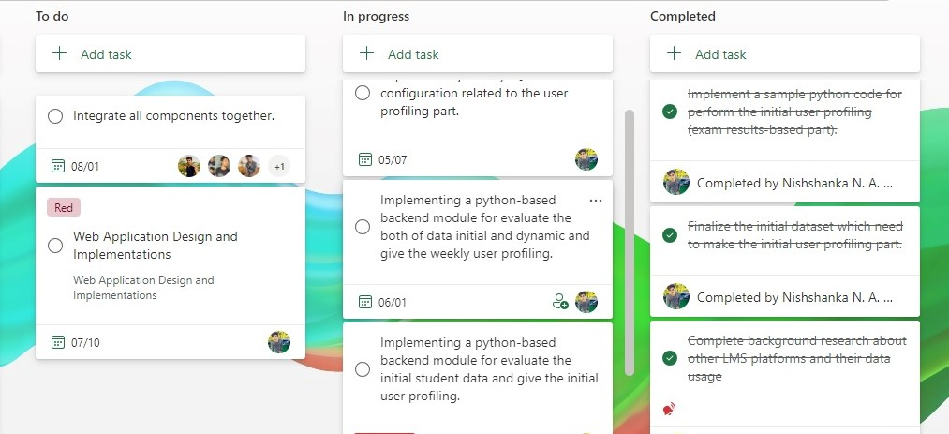
PROJECT PLANNING
IT21033032 | Nishshanka N.A.P.K.R | R24-112

Slide 15
RESEARCH METHODOLOGY
IT21033032 | Nishshanka N.A.P.K.R | R24-112

Slide 16
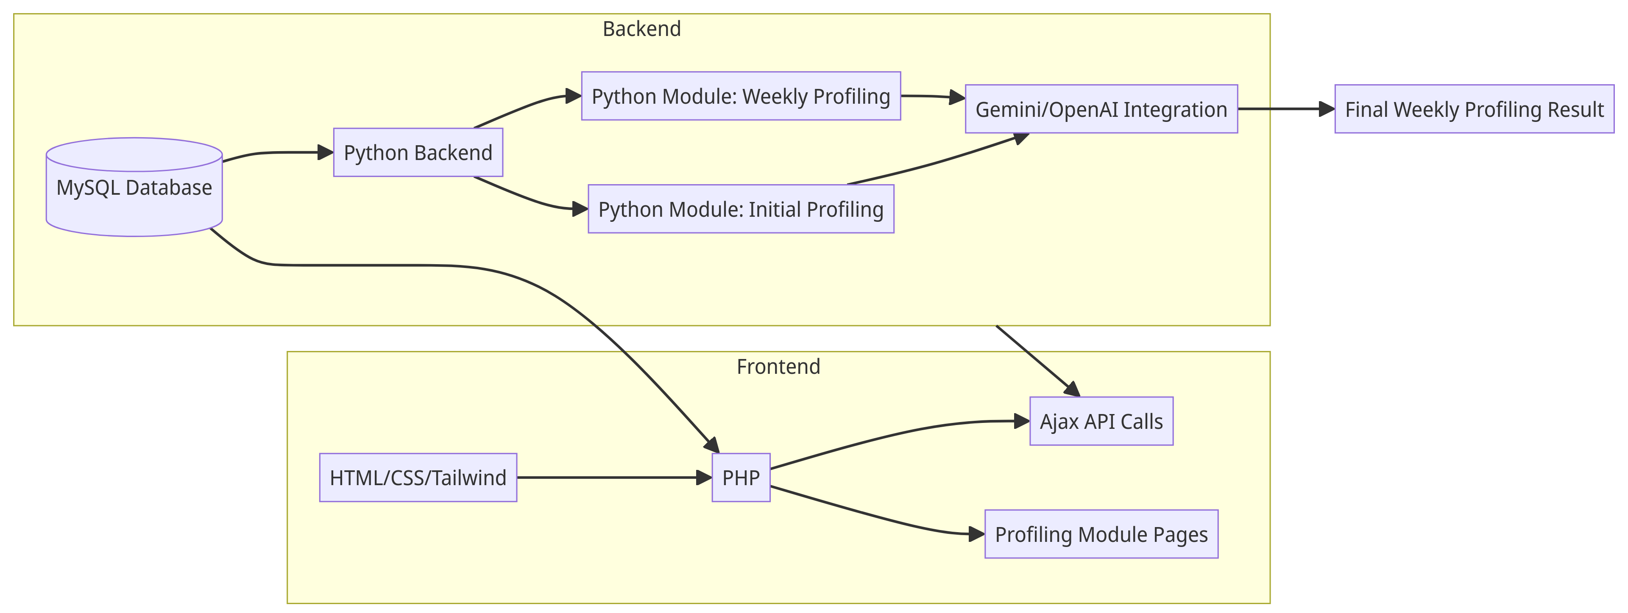
METHODOLOGY - SYSTEM DIAGRAM
Overall System Diagram of Component
IT21033032 | Nishshanka N.A.P.K.R | R24-112
Notes:
Frontend Components:
HTML/CSS/Tailwind: Responsible for the presentation of the profiling pages.
PHP: Acts as an intermediary, enabling communication between the frontend and backend.
Ajax API Calls: Facilitates data transfer between the frontend and backend.
Profiling Module Pages: Web pages dedicated to user profiling.
Backend Components:
Python Backend:
Initial Profiling Module: Evaluates initial student data.
Weekly Profiling Module: Analyzes both initial and dynamic data for weekly profiling.
MySQL Database: Stores the profiling data and configurations.
Gemini/OpenAI Integration: Produces the final profiling results using AI.
Connections:
The frontend communicates with the backend via Ajax API calls.
The profiling modules interact with the Gemini/OpenAI integration for enhanced profiling analysis.
MySQL serves data to both the backend and the profiling pages.

Slide 17
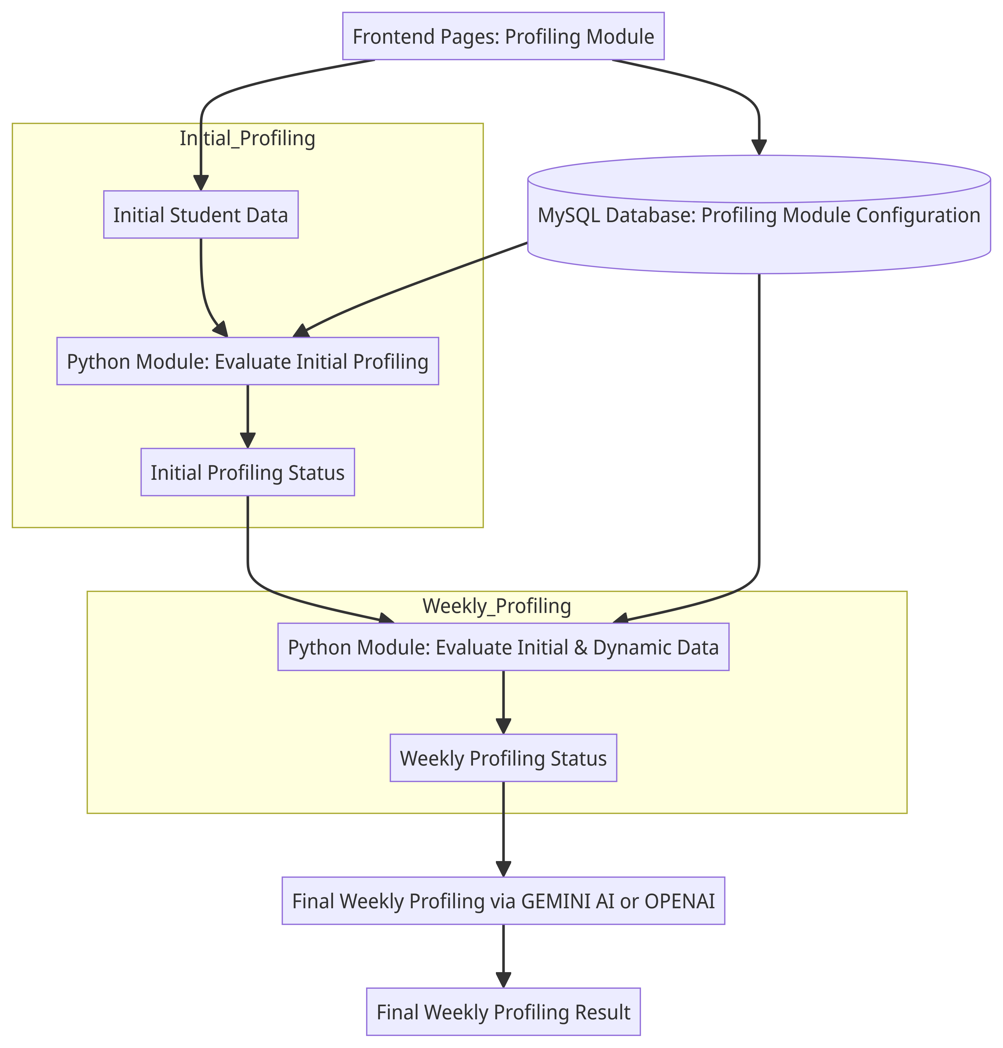
METHODOLOGY - PROCESS DIAGRAM
Overall Process
IT21033032 | Nishshanka N.A.P.K.R | R24-112
Notes:
Initial Profiling:
Student Data: Initial student information is collected.
Python Module (Initial Profiling): This backend module analyzes the initial data to generate the initial profile status.
Initial Profile Status: The output of the initial profiling process.
Weekly Profiling:
Python Module (Weekly Profiling): This module evaluates both initial and dynamic data to generate a weekly profile.
Weekly Profile Status: The weekly profiling result is produced.
Final Profiling via GEMINI AI or OPENAI:
GEMINI/OpenAI Integration: GEMINI AI or OpenAI provides the final weekly profiling status after further analysis.
Final Profiling Result: The final profiling result is presented.
MySQL Database & Frontend Pages:
MySQL Database: This stores and manages configuration data for the profiling module.
Frontend Pages: The pages that allow user interaction, submitting data, and accessing profiling results.

Slide 18
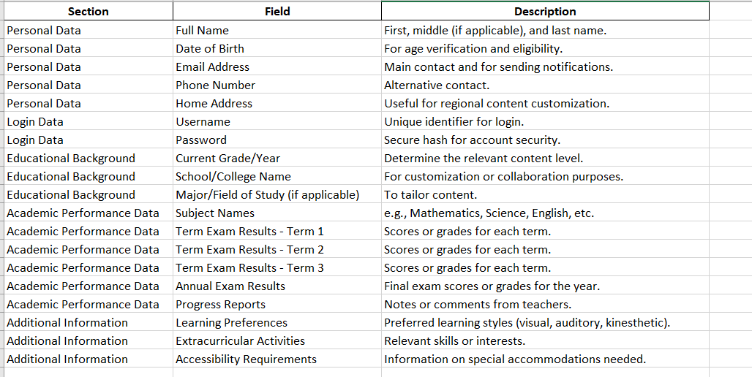
IMPLEMENTATION – PoC
Initial student dataset Finalized
IT21033032 | Nishshanka N.A.P.K.R | R24-112

Slide 19
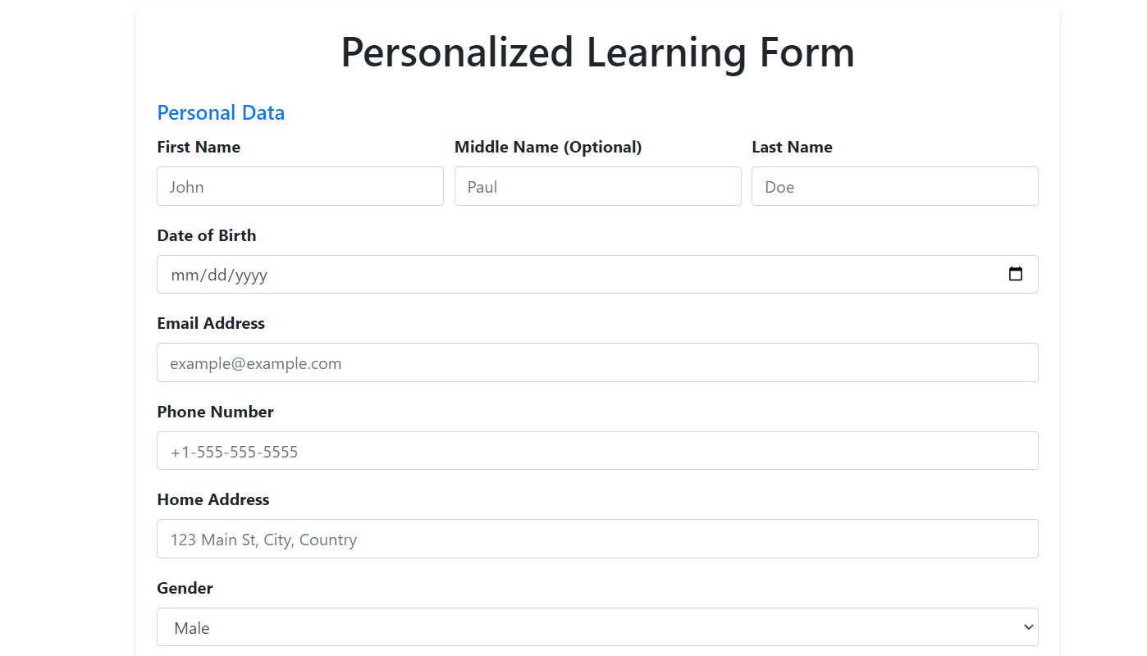
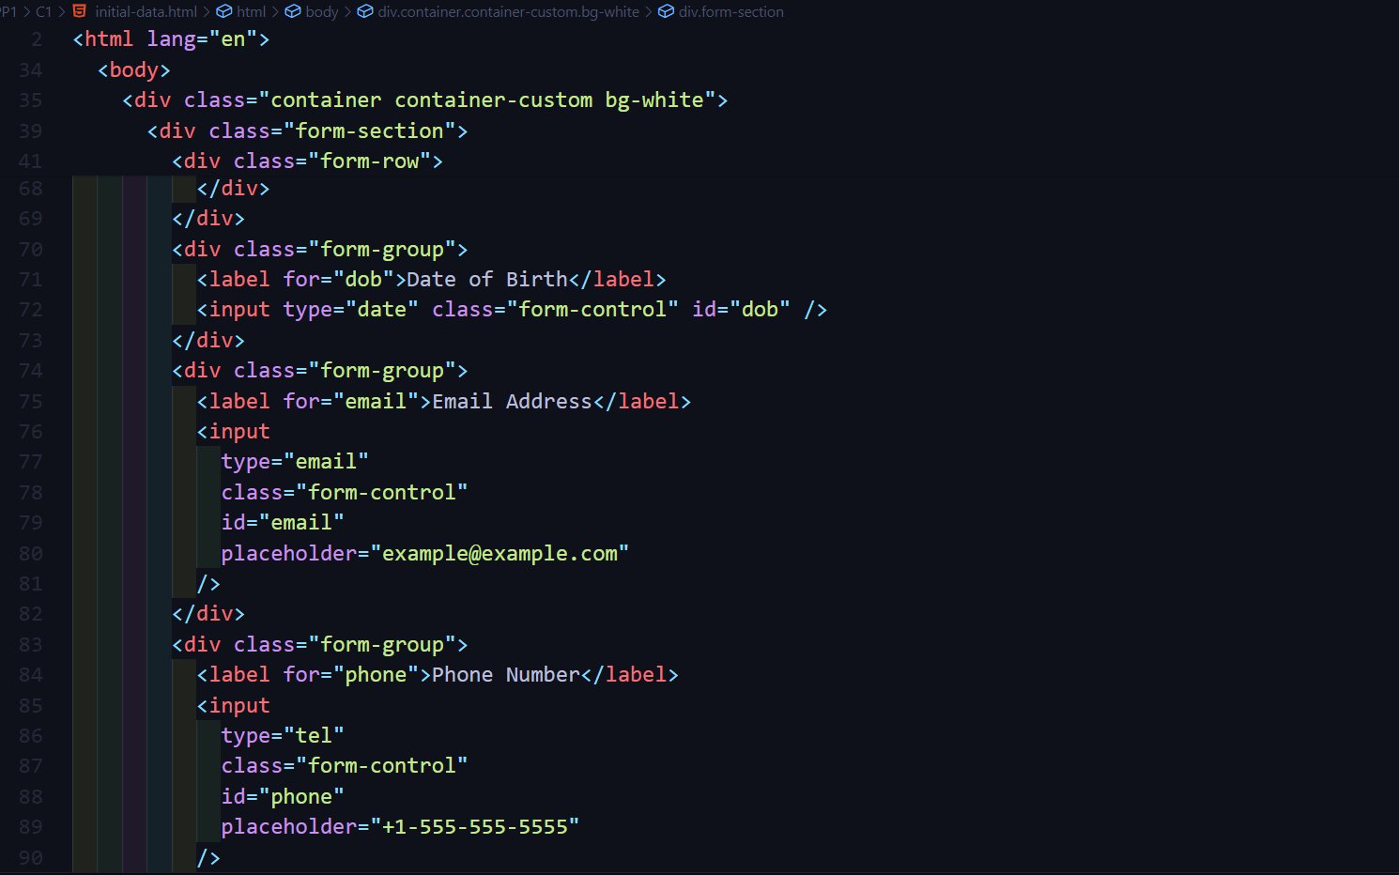
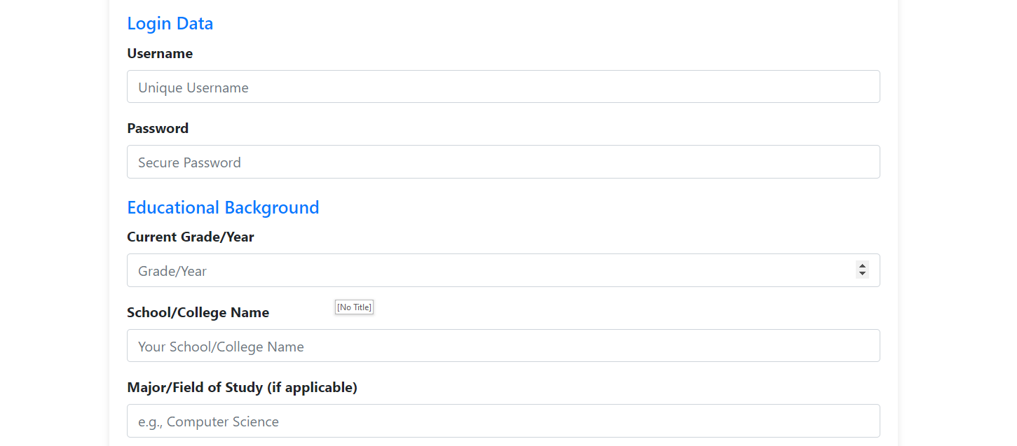
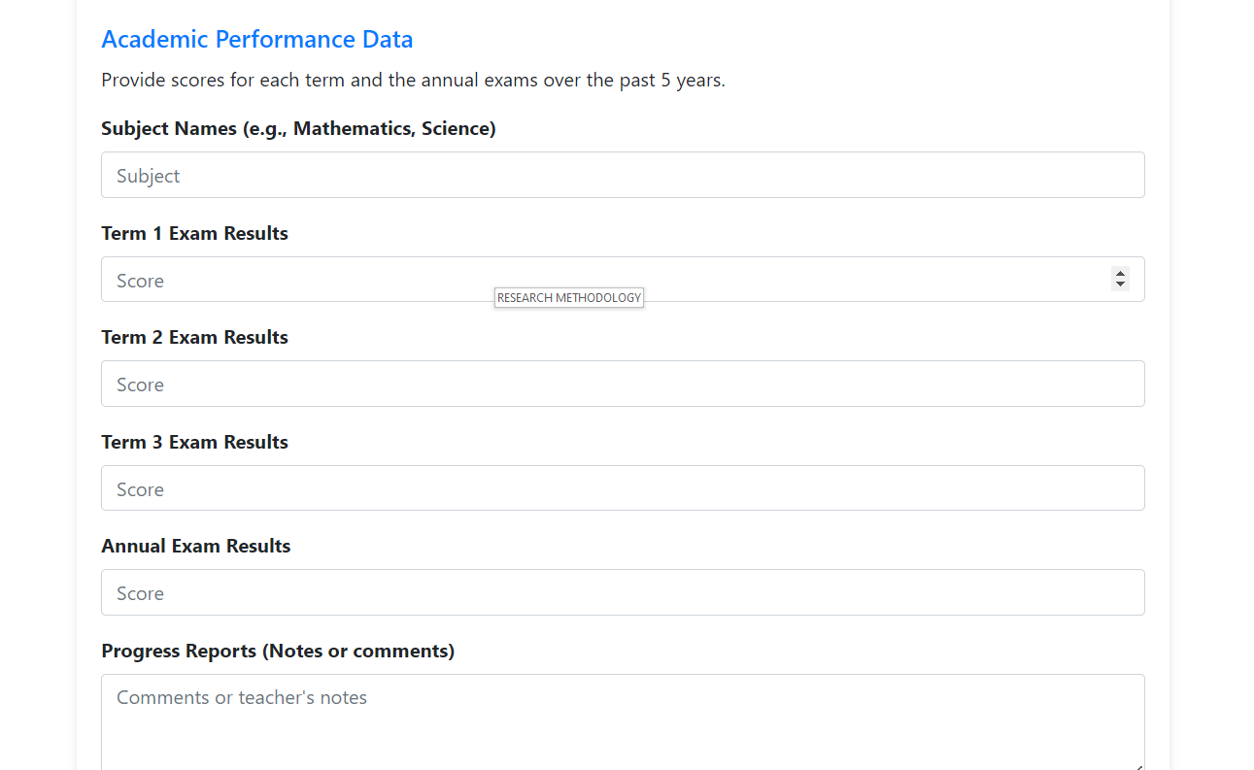
IMPLEMENTATION – PoC
Initial Data gathering form
IT21033032 | Nishshanka N.A.P.K.R | R24-112

Slide 20
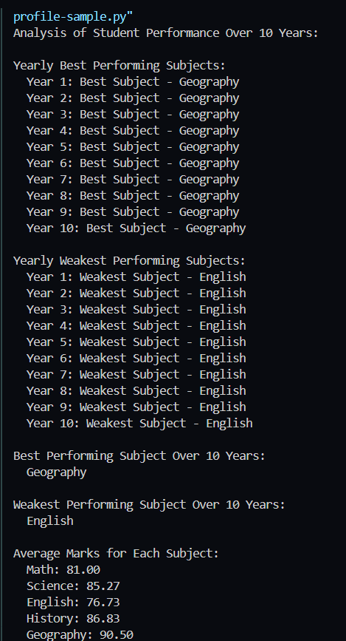
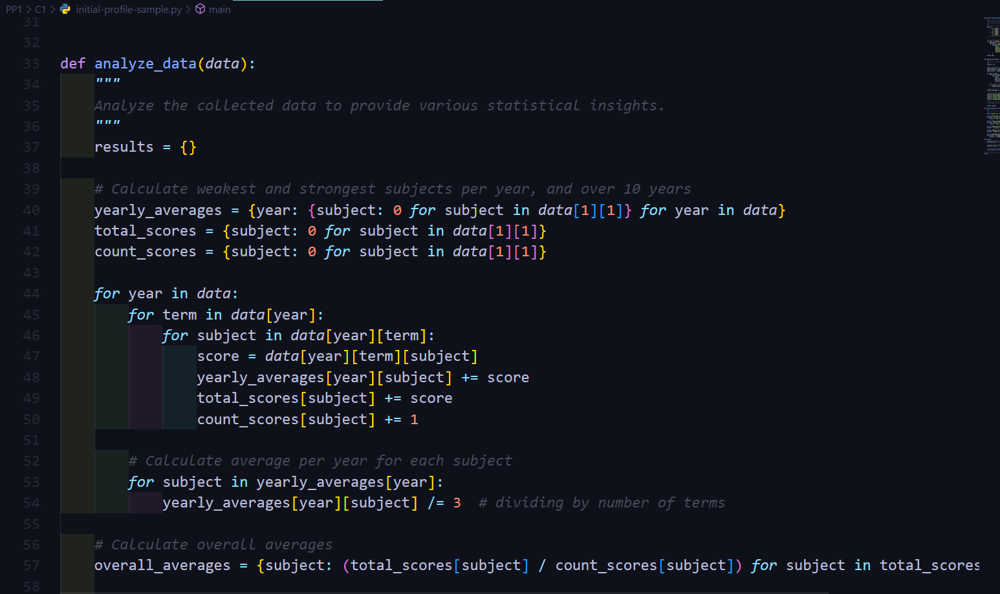

IMPLEMENTATION – PoC
Initial Data sample analysis python code
RESULTS
IT21033032 | Nishshanka N.A.P.K.R | R24-112

Slide 21
IT21021602 | Abeykoon R.M.S.P
Objective : Implementing Adaptive Recommendation Engine for suggest learning resources and predict the student performance using AIML
Specialization: Information Technology
IT21021602 | Abeykoon R.M.S.P | R24-112

Slide 22
INTRODUCTION
IT21021602 | Abeykoon R.M.S.P | R24-112

Slide 23
RESEARCH PROBLEM
To what extent does the Adaptive Recommendation Engine improve the relevance and appropriateness of learning content recommendations compared to traditional e-learning systems?
What is the impact of real-time adjustments in recommendations on user engagement within the e-learning platform?
How is the implement AIML module for give prediction for future about the students' leering performance?
How does the Adaptive Recommendation Engine compare with traditional e-learning systems in terms of providing tailored learning experiences?
IT21021602 | Abeykoon R.M.S.P | R24-112

Slide 24
SPECIFIC AND SUB OBJECTIVES
Implement a python module for analysis the initial educational data of student and identify the weak to best scores.
Implement a python-based backend module for analysis the weekly interest of user about the subjects for setup the priority list of learning resource suggestion.
Develop a AIML model to predict the student performance if student work according to the suggested learning plan.
Implementing the MySQL database configuration related to the component.
Implementing the all-relevant frontend pages related to the component.
IT21021602 | Abeykoon R.M.S.P | R24-112

Slide 25
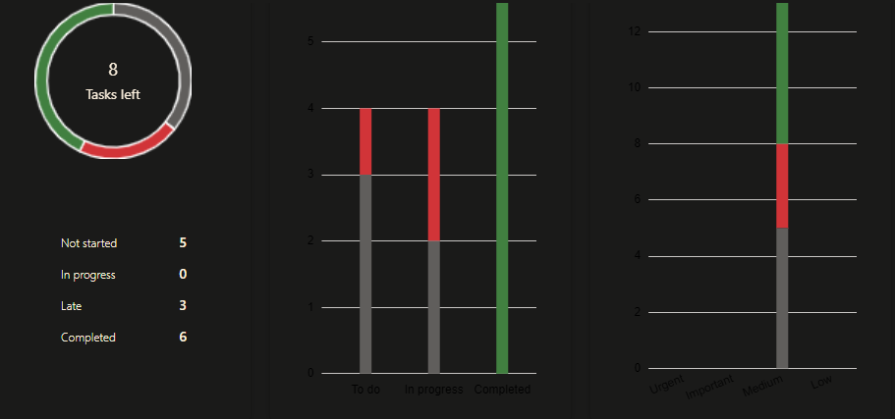
COMPLETED TASKS
Complete background research about other LMS platforms and their data usage.
Implement a simple python code for identify the weak subjects from initial user exam data.
Identify the scores types which need to process with AIML part to give performance prediction.
Research about AIML algorithms which can use to this AIML implementation.
Identify and finalize the technology stack and backend configurations and database configurations for overall system.
Learn about the relate technologies (system engineering terms) for how to setup this kind of system in real world.
IT21021602 | Abeykoon R.M.S.P | R24-112

Slide 26
IN PROGRESS TASKS
Implementing a python-based backend module for evaluate the initial student data and give the initial user profiling.
Implementing a python-based backend module for evaluate the both of data initial and dynamic and give the weekly user profiling.
Implementing the MySQL database configuration related to the user profiling part.
Learn about more AIML technologies for implement the AIML module.
IT21021602 | Abeykoon R.M.S.P | R24-112

Slide 27
TASK TO DO
Web Application Design and Implementations
Learn about more AIML technologies for implement the AIML module.
Integrate all components together.
Conduct a QA process to validate all.
IT21021602 | Abeykoon R.M.S.P | R24-112

Slide 28
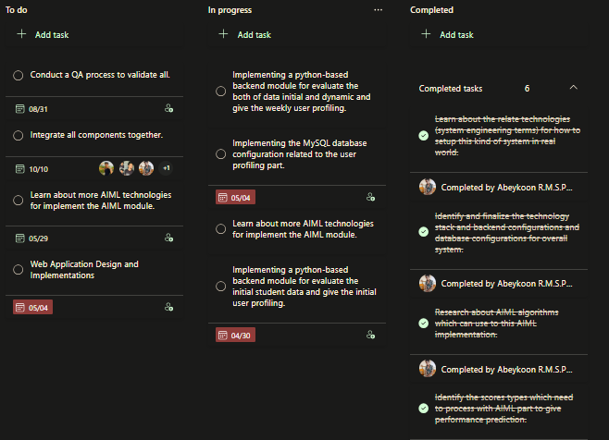
PROJECT PLANNING
IT21021602 | Abeykoon R.M.S.P | R24-112

Slide 29
RESEARCH METHODOLOGY
IT21021602 | Abeykoon R.M.S.P | R24-112

Slide 30
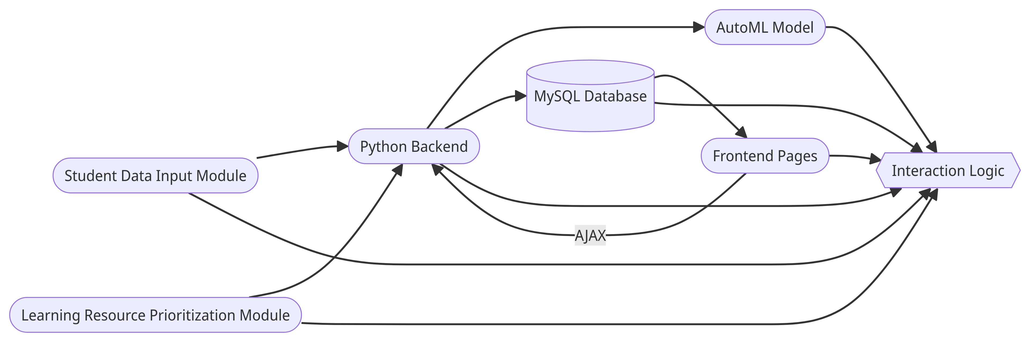
METHODOLOGY - SYSTEM DIAGRAM
Overall System Diagram of Component
IT21021602 | Abeykoon R.M.S.P | R24-112
Notes:
Student Data Input Module: Accepts the initial data from the student and identifies the weak subjects.
Learning Resource Prioritization Module: Analyzes students' weekly interests and sets up a prioritized learning resource list.
AutoML Model: Predicts the student's performance if they follow the suggested learning plan, using the best-performing machine-learning algorithm identified through AutoML.
Database: MySQL database to store user profiling and other necessary data.
Frontend Pages: HTML, CSS, Tailwind, and PHP-based frontend pages, communicating with the backend via AJAX API calls.
Backend: Python-based backend to analyze and prioritize learning resources and communicate with the AutoML model.
Interaction Logic: Explains how different components interact.

Slide 31
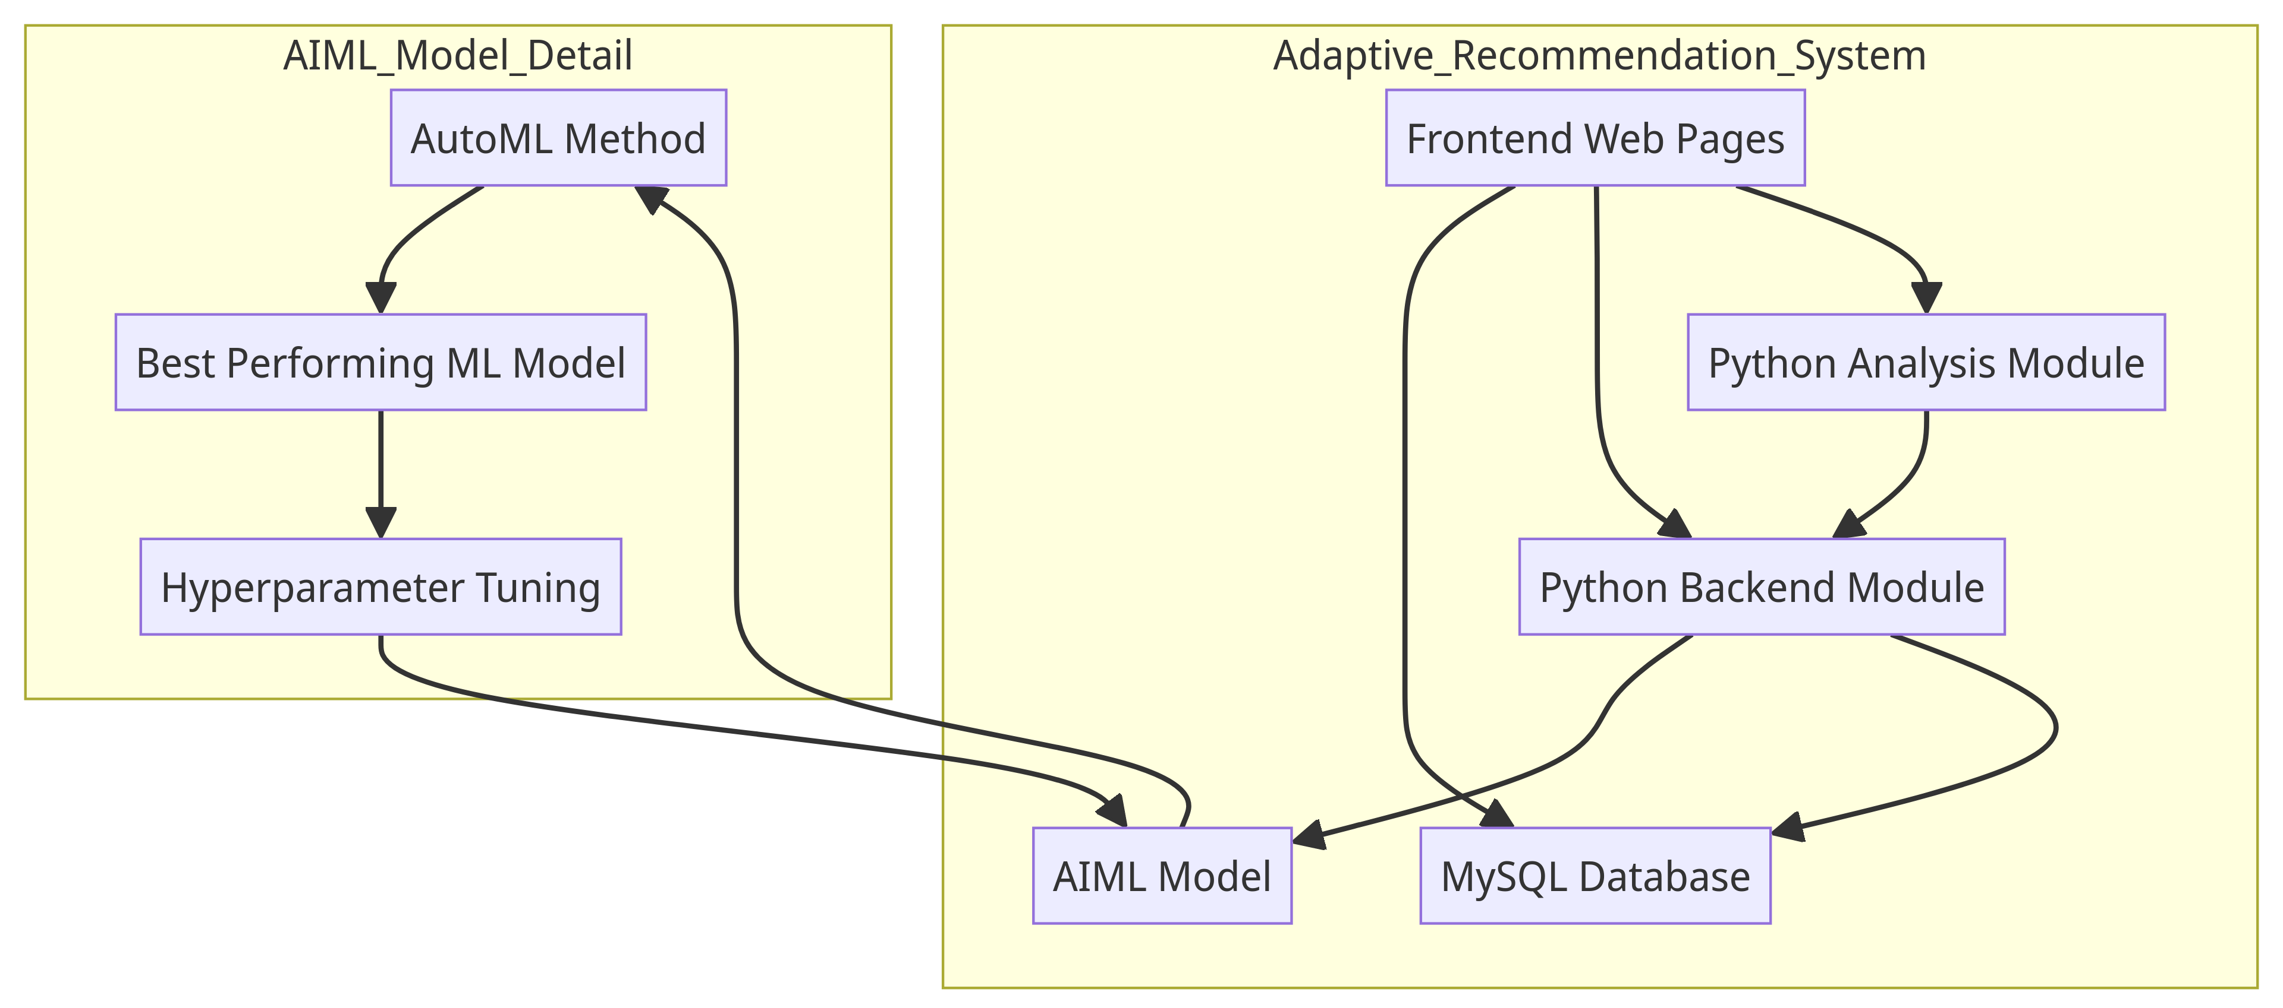
METHODOLOGY - PROCESS DIAGRAM
Overall Process
IT21021602 | Abeykoon R.M.S.P | R24-112
Notes:
Python Analysis Module: Analyzes initial educational data to identify students' weak subjects and provides learning resource recommendations accordingly.
Python Backend Module: Analyzes weekly student interests in various subjects to generate a prioritized list of suggested learning resources.
AIML Model: Predicts student performance based on the suggested learning plan using the best-performing Machine Learning model:
AutoML Method: Explores different machine learning algorithms and identifies the best-performing one for the dataset.
Best Performing ML Model: The most suitable machine learning model is chosen based on the AutoML analysis.
Hyperparameter Tuning: Optimizes the selected model's hyperparameters to improve performance.
hyperparameters are settings or configurations that are external to the model and are not learned from the data.
MySQL Database: Stores user profiling data and learning resource suggestions.
Frontend Web Pages: Web pages through which students can enter initial data, access personalized learning resources, and track their performance.

Slide 32
METHODOLOGY – AIML Module
Score Processing with ML
1. Individual Subject Marks: Marks obtained by students in each subject.
2. Overall Average: Average marks of each student across all subjects.
3. Subject-wise Averages and Deviations: Average marks and standard deviations of each student in individual subjects.
4. Attendance: Attendance record of each student.
5. Study Hours: Time spent studying by each student.
6. Homework Completion Rate: Percentage of homework assignments completed by each student.
7. Test Scores: Scores obtained by students in standardized tests or assessments.
8. Participation in Extra-curricular Activities: Whether a student participates in sports, clubs, or other activities.
9. Parental Education Level: Education level attained by the student's parents, which can be indicative of socio-economic status.
10. Student Demographics: Gender, age, and other demographic information.
IT21021602 | Abeykoon R.M.S.P | R24-112
Notes:
Past data evaluate ….
New data evaluate – behavior
Plan –
AIML result – predict if he work according to our plan - results

Slide 33
METHODOLOGY – AIML Module Cont.
AIML Model selection
Machine Learning Models that can be used,
Ref: https://scikit-learn.org/stable/supervised_learning.html
Since we can use lot of Machine Learning algorithms, It is better to use the autoML method to identify the best algorithm to use
AutoML algorithms typically explore a wide range of machine learning and select the ones that perform best on the given dataset.
1. Linear Regression | 2. Logistic Regression | 3. Decision Trees
4. Random Forests | 5. Support Vector Machines (SVM) | 6. Neural Networks
IT21021602 | Abeykoon R.M.S.P | R24-112

Slide 34
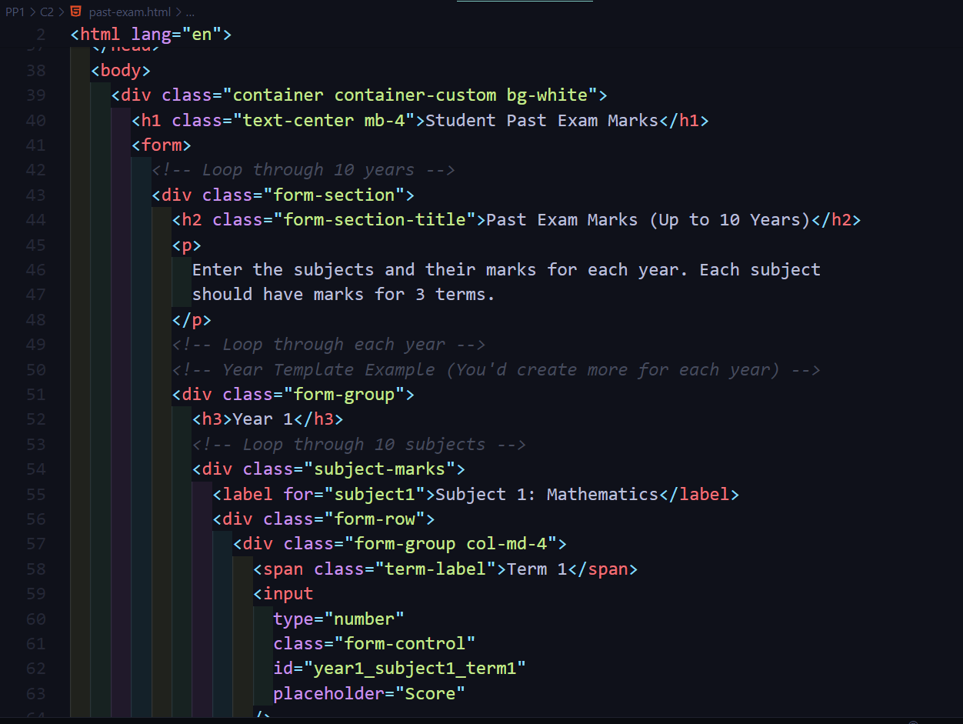
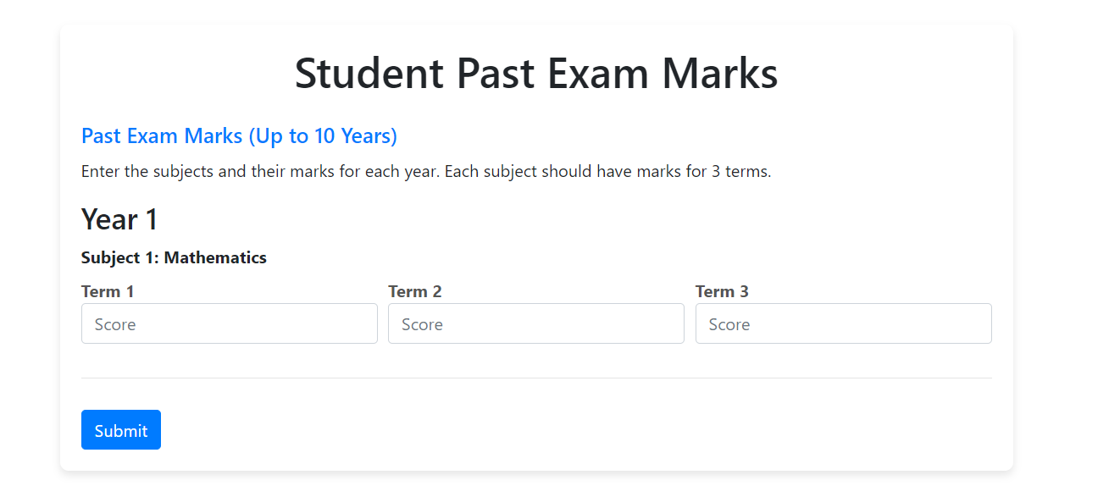
IMPLEMENTATION – PoC
Past Exam result gather form
IT21021602 | Abeykoon R.M.S.P | R24-112

Slide 35
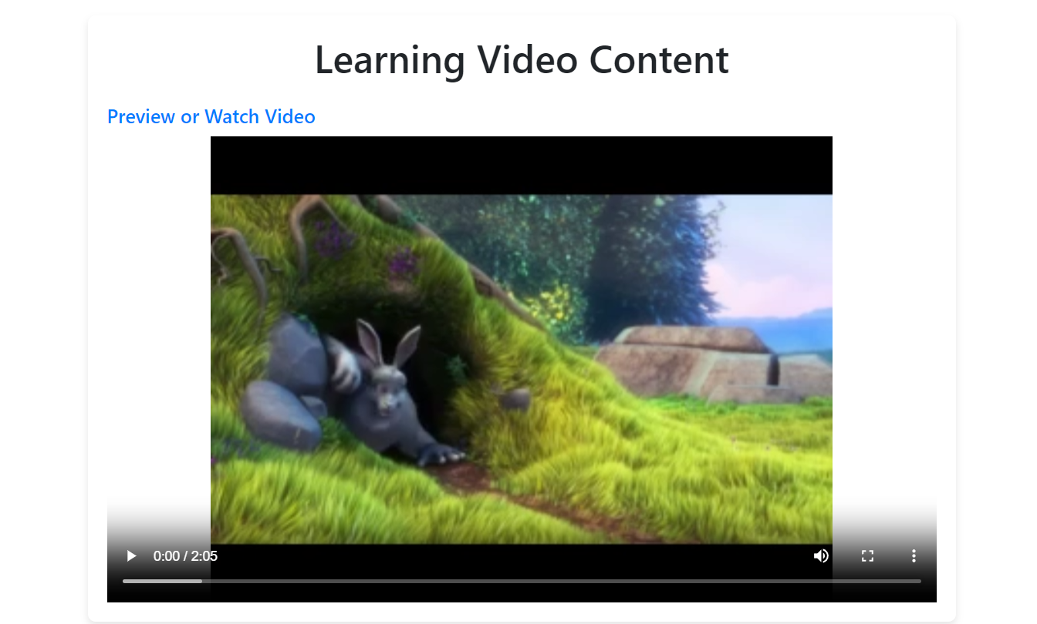
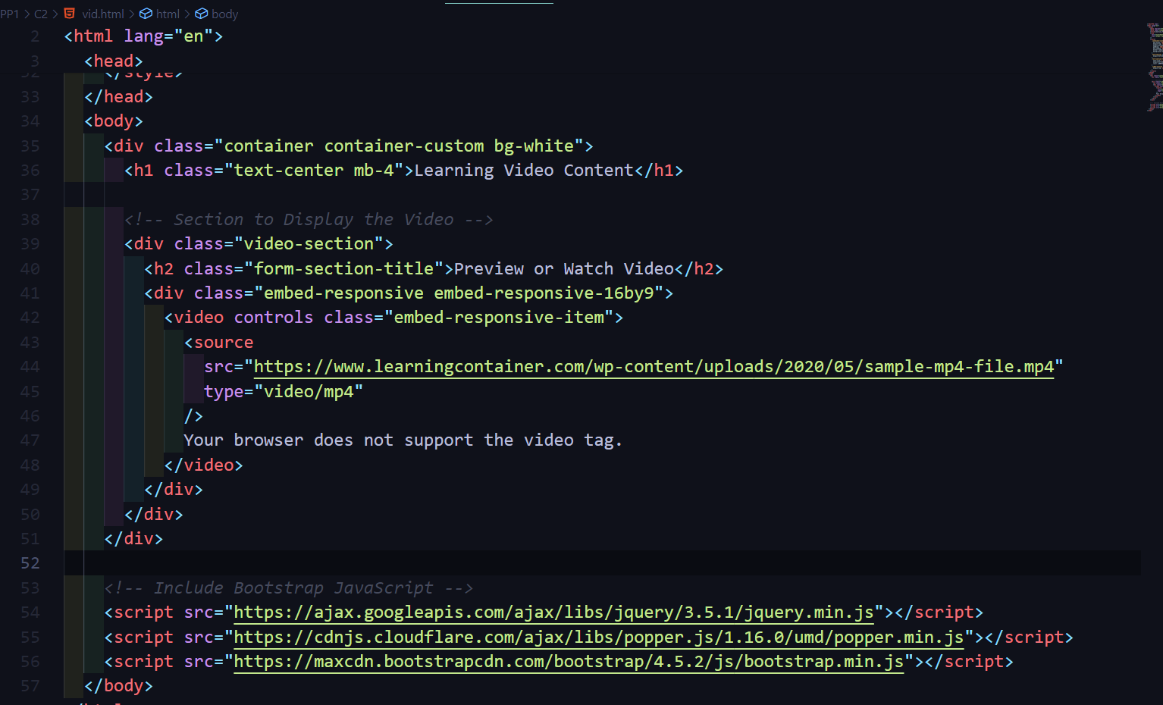
IMPLEMENTATION – PoC
Learn material showing page
IT21021602 | Abeykoon R.M.S.P | R24-112

Slide 36
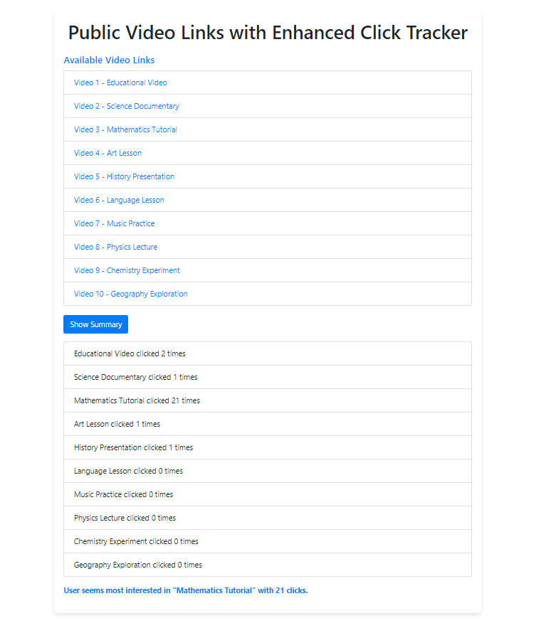
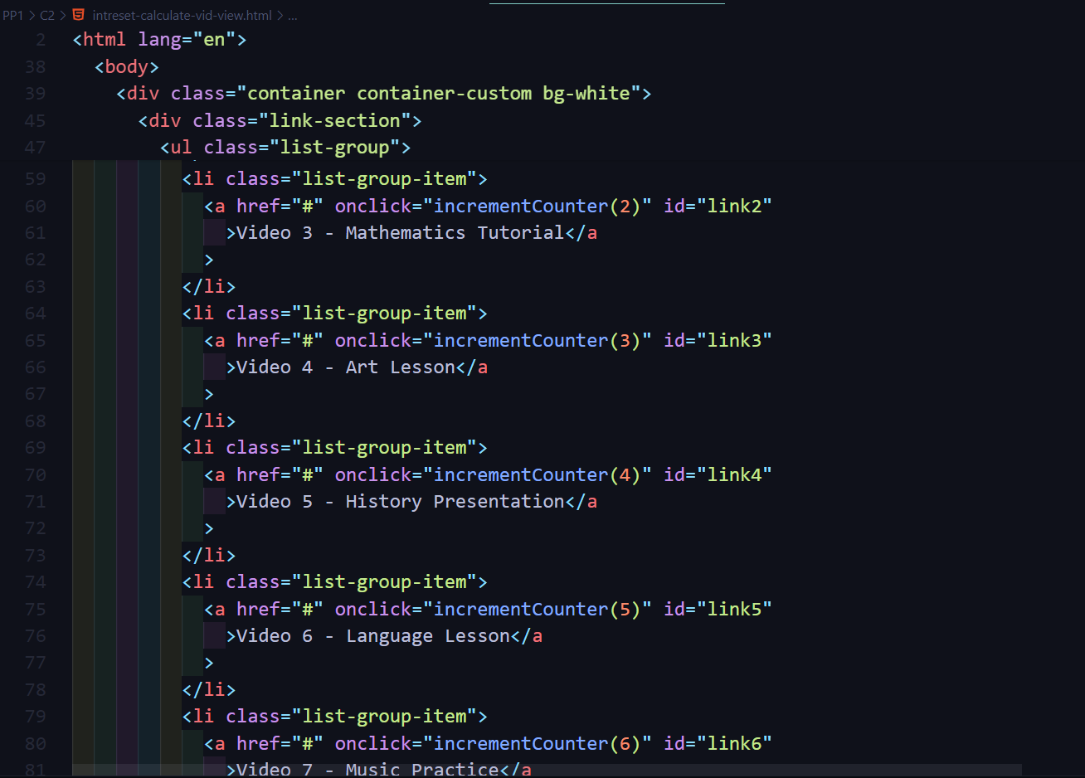
IMPLEMENTATION – PoC
User Interest analysis page (identify priority according to the access times of content)
RESULTS
IT21021602 | Abeykoon R.M.S.P | R24-112

Slide 37
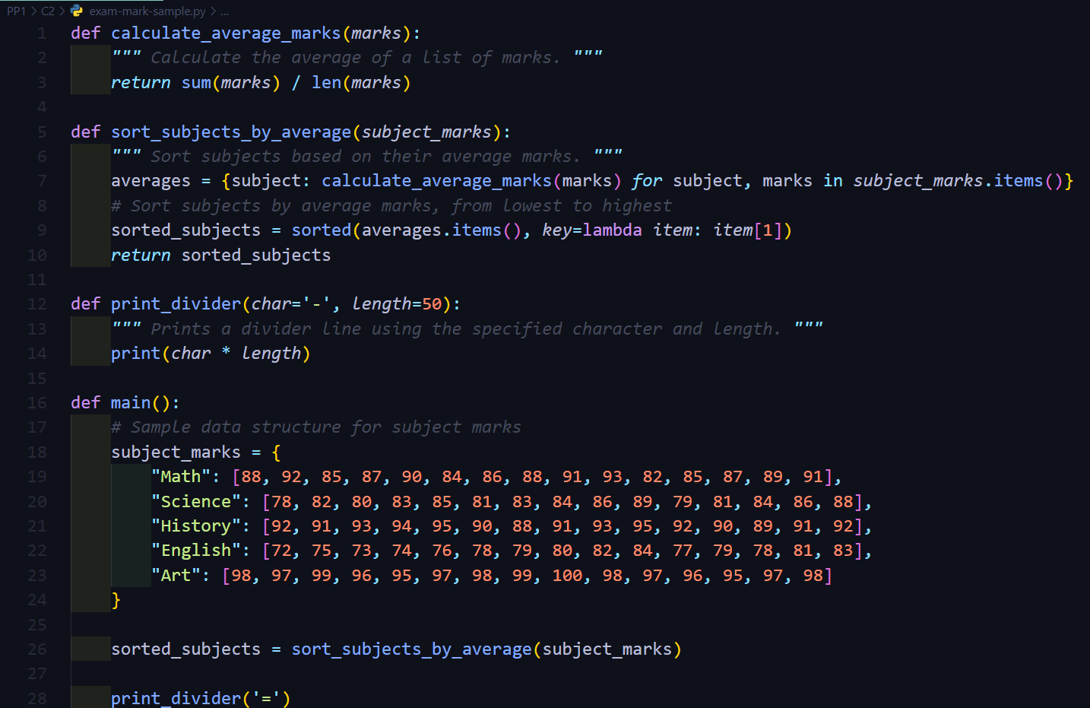
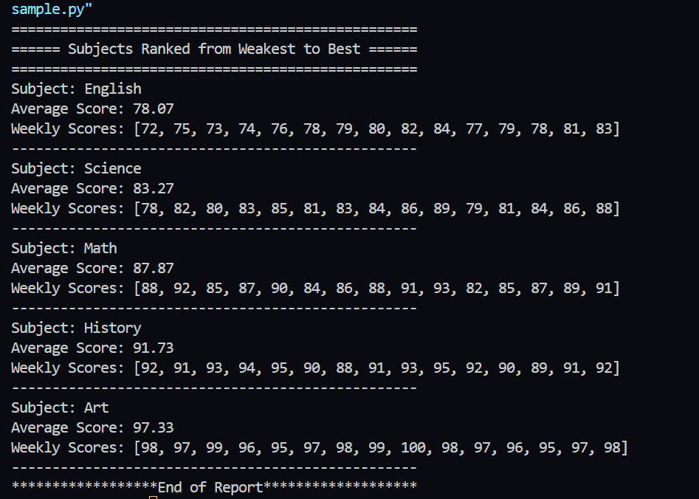
IMPLEMENTATION – PoC
Weak Subjects identification script from initial user data
RESULTS
IT21021602 | Abeykoon R.M.S.P | R24-112

Slide 38
It21032806 | Jayasinghe K.A.K.N
Objective : The Dynamic Learning Pathway Generator customizes learning experiences based on individual traits, optimizing efficiency and engagement through machine learning.
Specialization: Information Technology
IT21032806 | Jayasinghe K.A.K.N | R24-112

Slide 39
INTRODUCTION
IT21032806 | Jayasinghe K.A.K.N | R24-112

Slide 40
RESEARCH PROBLEM
How to effectively tailor learning pathways to accommodate diverse individual characteristics, preferences, and goals?
How can learning pathways be optimized to maximize learning outcomes while minimizing time and effort?
How to develop a system that continuously adjusts learning pathways based on user feedback, performance, and evolving educational needs?
What strategies can be employed to enhance user motivation, engagement, and satisfaction with the learning process?
How to provide a diverse range of content formats and difficulty levels to promote a comprehensive and well-rounded learning experience?
IT21032806 | Jayasinghe K.A.K.N | R24-112

Slide 41
SPECIFIC AND SUB OBJECTIVES
The Dynamic Learning Pathway Generator aims to profile users based on their learning styles, proficiency levels, preferences, and goals.
It recommends personalized learning materials, such as lectures and quizzes, tailored to individual preferences and proficiency levels.
Efficiency is optimized by analysing user behaviour to minimize redundancy and maximize knowledge retention in content sequencing.
Adaptation mechanisms continuously monitor user feedback to adjust learning pathways in real-time, ensuring relevance and effectiveness.
Motivation and engagement strategies, like goal-setting and interactive features, are integrated to enhance user engagement throughout the learning process.
IT21032806 | Jayasinghe K.A.K.N | R24-112

Slide 42
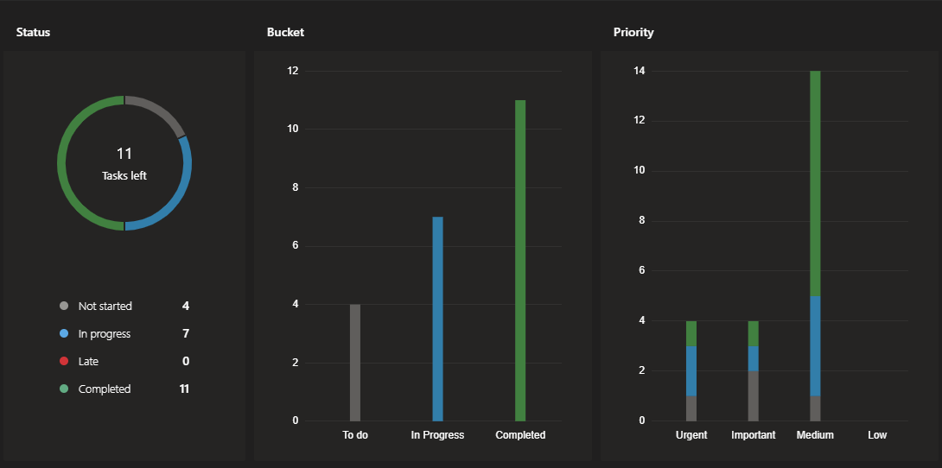
COMPLETED TASKS
Conducted comprehensive research on existing Learning Management System (LMS) platforms and their data usage.
Explored various AI and machine learning algorithms suitable for implementing the Dynamic Learning Pathway Generator.
Curated and finalized a dataset comprising 5000 rows for identifying user learning styles.
Developed and implemented a model for the Dynamic Learning Pathway Generator, integrated with an API for seamless interaction.
Identified suitable technology stack, backend configurations, and database configurations for the system.
Acquired knowledge about related technologies and best practices for real-world implementation of educational technology systems.
IT21032806 | Jayasinghe K.A.K.N | R24-112

Slide 43
IN PROGRESS TASKS
Conducting usability testing to gather feedback on the prototype of the Dynamic Learning Pathway Generator.
Refining the user interface design based on feedback and usability testing results.
Implementing the MySQL database configuration related to the Dynamic Learning pathway Generator part.
Learn about more AIML technologies for develop the AIML module.
IT21032806 | Jayasinghe K.A.K.N | R24-112

Slide 44
TASK TO DO
Web Application Design and Implementations
Integrate all components together.
Conduct a QA process to validate all.
Enhance the model to Predict Suitable Learning time, Goals And other Data
Implement A frontend
Finalize Database Connection
IT21032806 | Jayasinghe K.A.K.N | R24-112

Slide 45
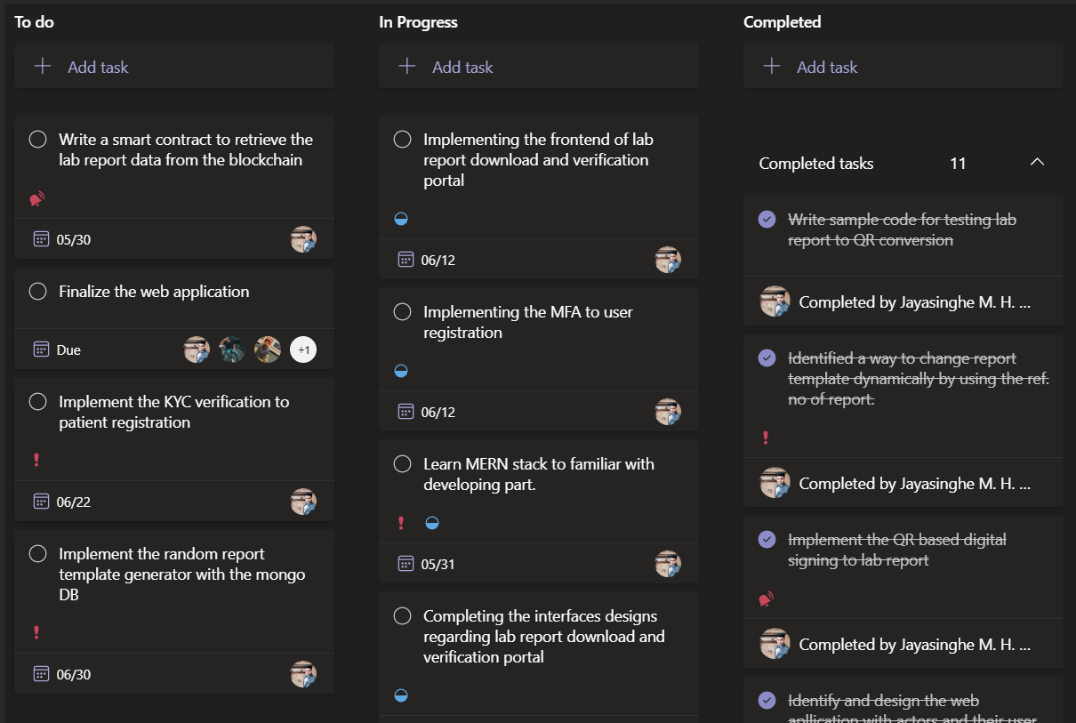
PROJECT PLANNING
IT21032806 | Jayasinghe K.A.K.N | R24-112

Slide 46
RESEARCH METHODOLOGY
IT21032806 | Jayasinghe K.A.K.N | R24-112

Slide 47
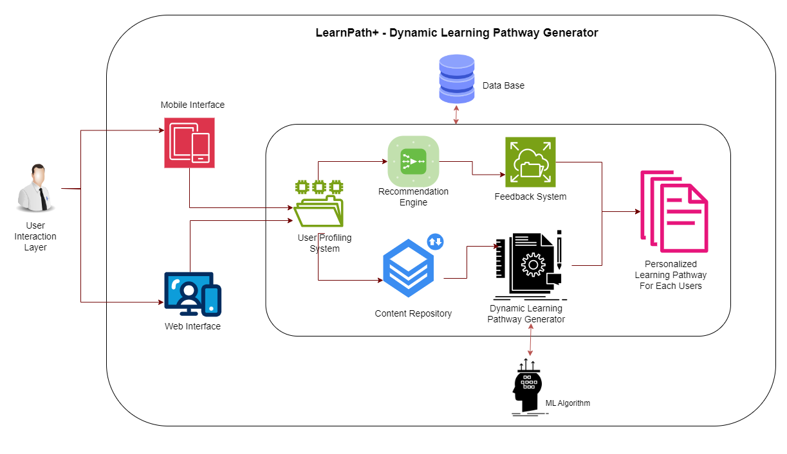
METHODOLOGY - SYSTEM DIAGRAM
System Architecture Diagram
IT21032806 | Jayasinghe K.A.K.N | R24-112

Slide 48
METHODOLOGY – AIML Module
Score Processing with ML
1. Data Collection: Gather a dataset with examples of individuals and their corresponding learning styles along with the factors influencing those styles.
2. Data Preprocessing: Preprocess the data by encoding categorical variables, handling missing values, and scaling numerical features if necessary.
3. Feature Engineering: Extract relevant features from the data that could influence learning style preferences. This may involve transforming or combining existing features.
4. Model Selection: Choose an appropriate machine learning model for classification. Since you have categorical output (learning style), you might consider models like Decision Trees, Random Forests, or even a Neural Network.
5. Training: Split your data into training and testing sets. Train the selected model on the training data.
6. Evaluation: Evaluate the trained model using appropriate metrics such as accuracy, precision, recall, or F1-score on the testing data.
7. Hyperparameter Tuning: Fine-tune the model hyperparameters to improve performance, if necessary.
8. Prediction: Once you have a trained model, you can use it to predict the learning style for new individuals based on their input features.
IT21021602 | Abeykoon R.M.S.P | R24-112
Notes:
Past data evaluate ….
New data evaluate – behavior
Plan –
AIML result – predict if he work according to our plan - results

Slide 49
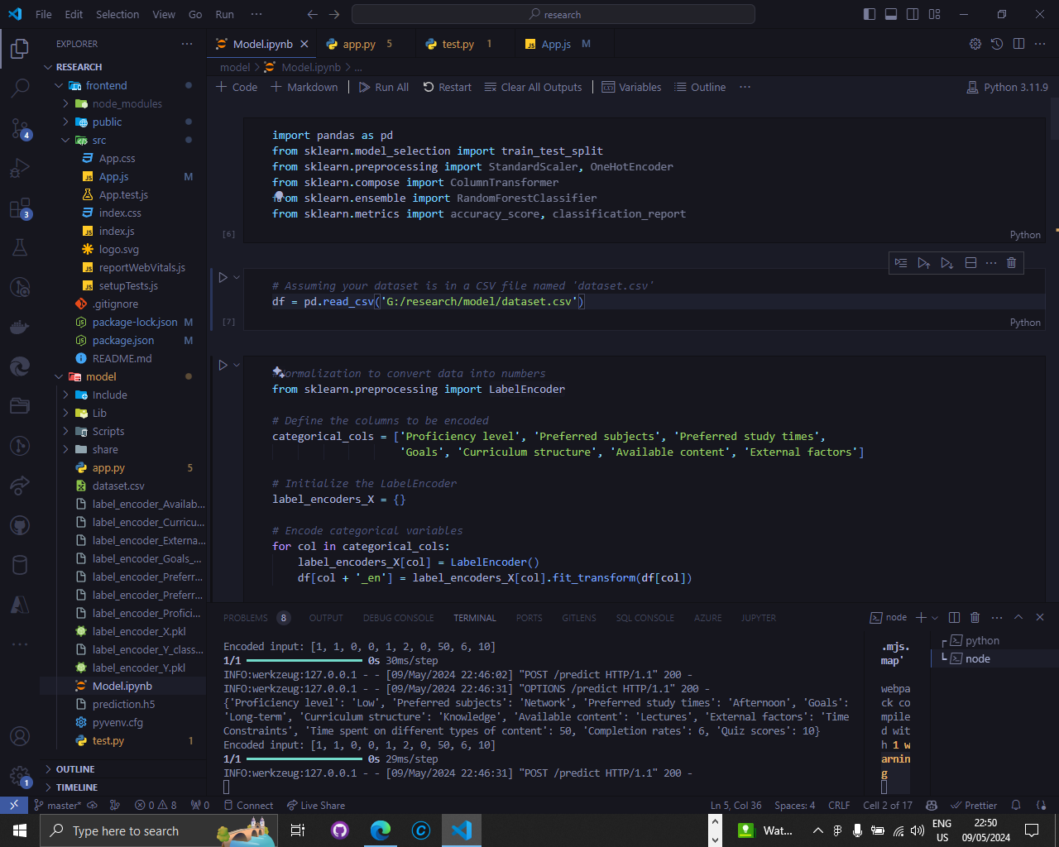
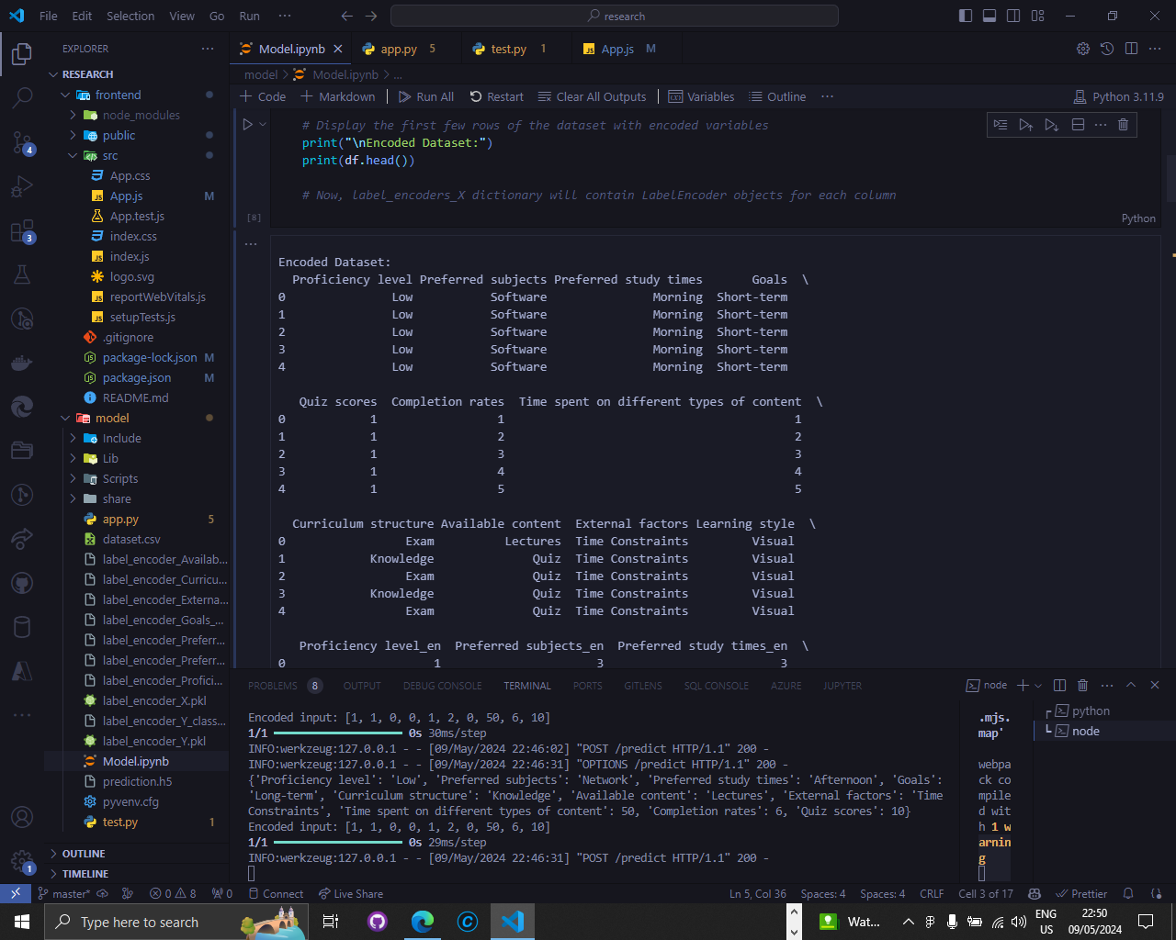
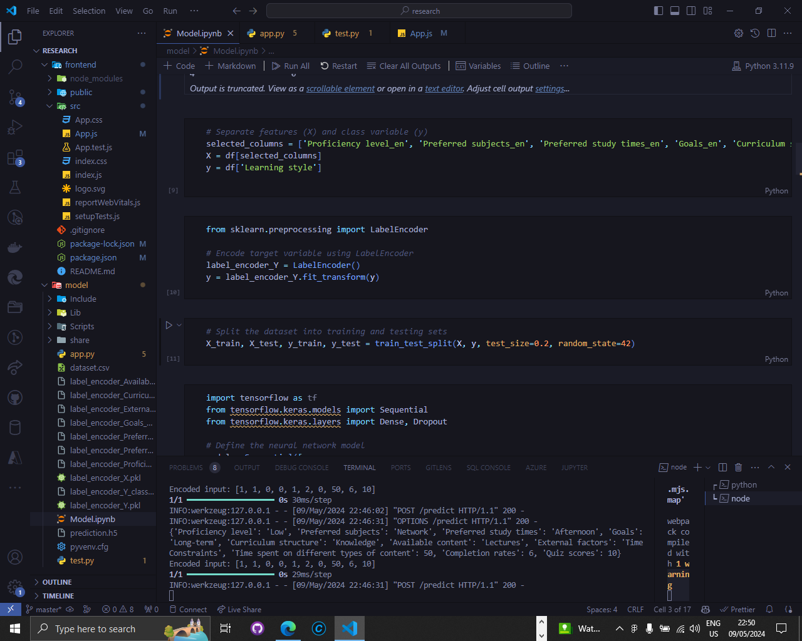
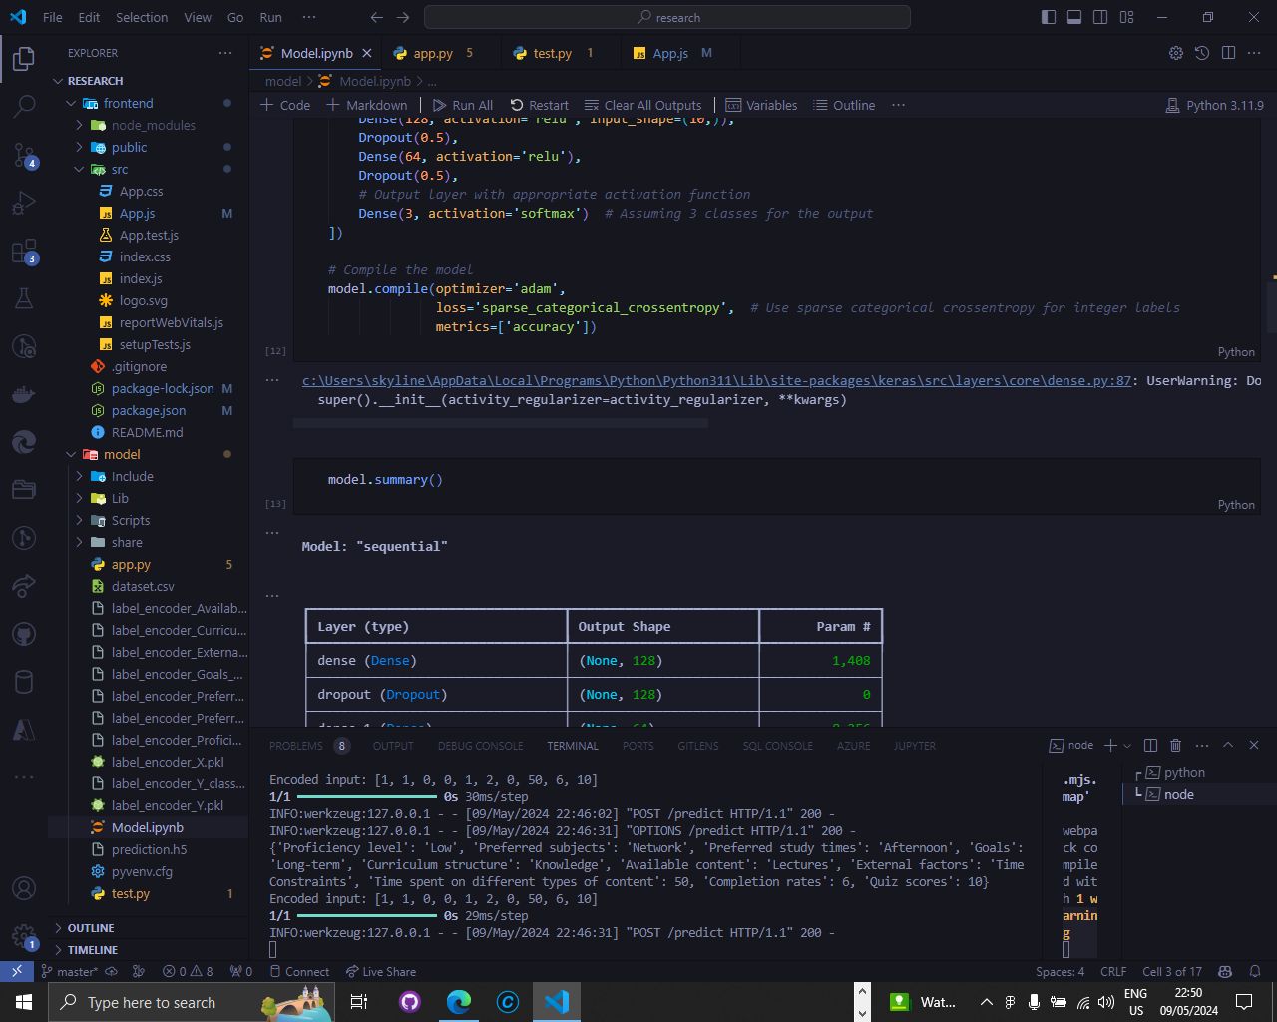
IMPLEMENTATION – PoC
Dynamic Learning pathway generator – Model ( Learning Style )
IT21032806 | Jayasinghe K.A.K.N | R24-112

Slide 50
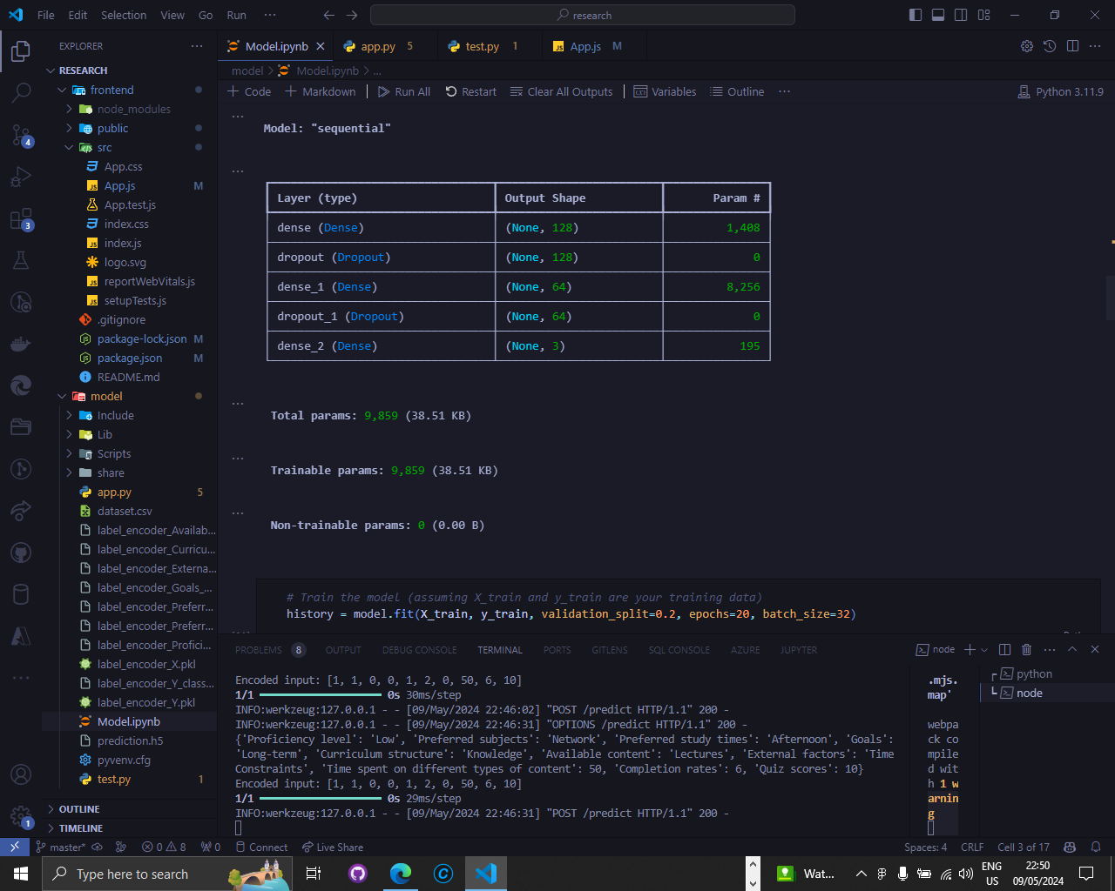
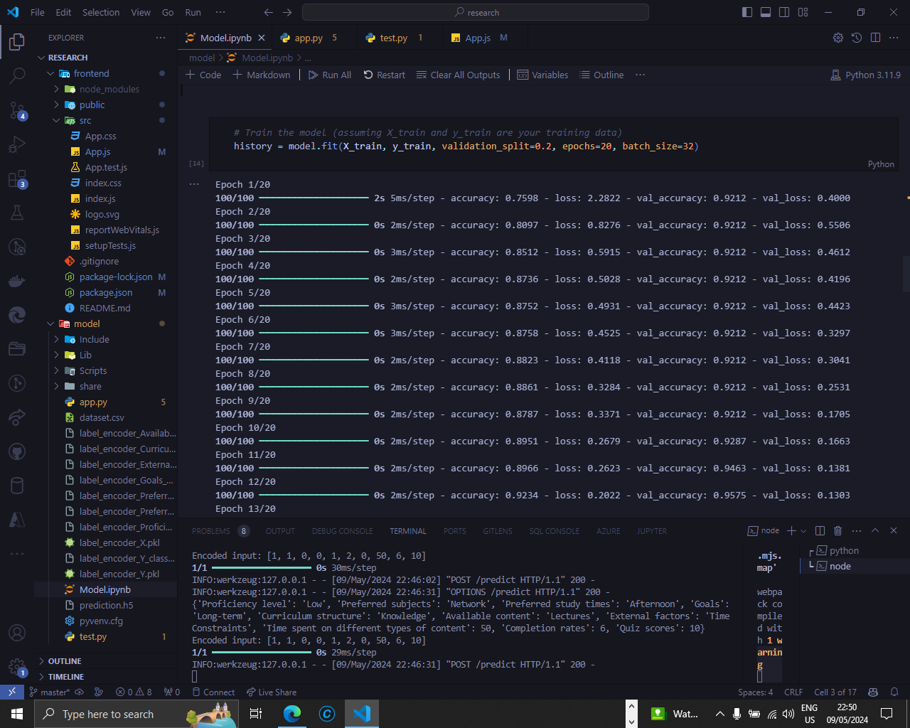
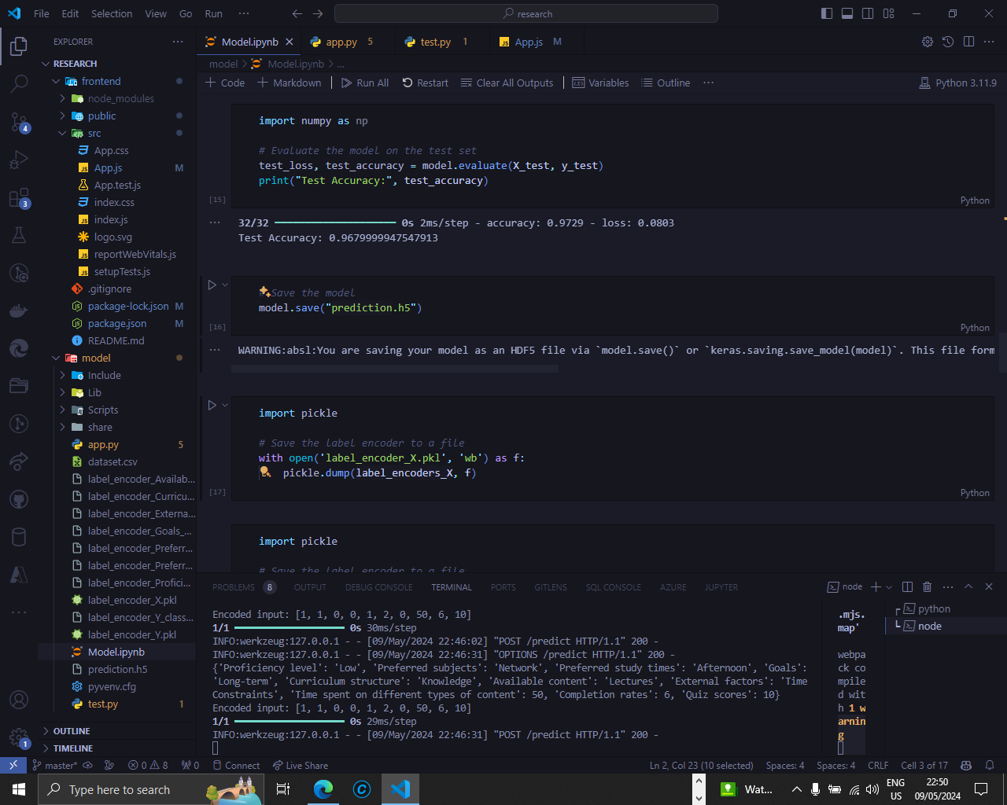
IMPLEMENTATION – PoC
Dynamic Learning pathway generator – Model ( Learning Style )
IT21032806 | Jayasinghe K.A.K.N | R24-112

Slide 51
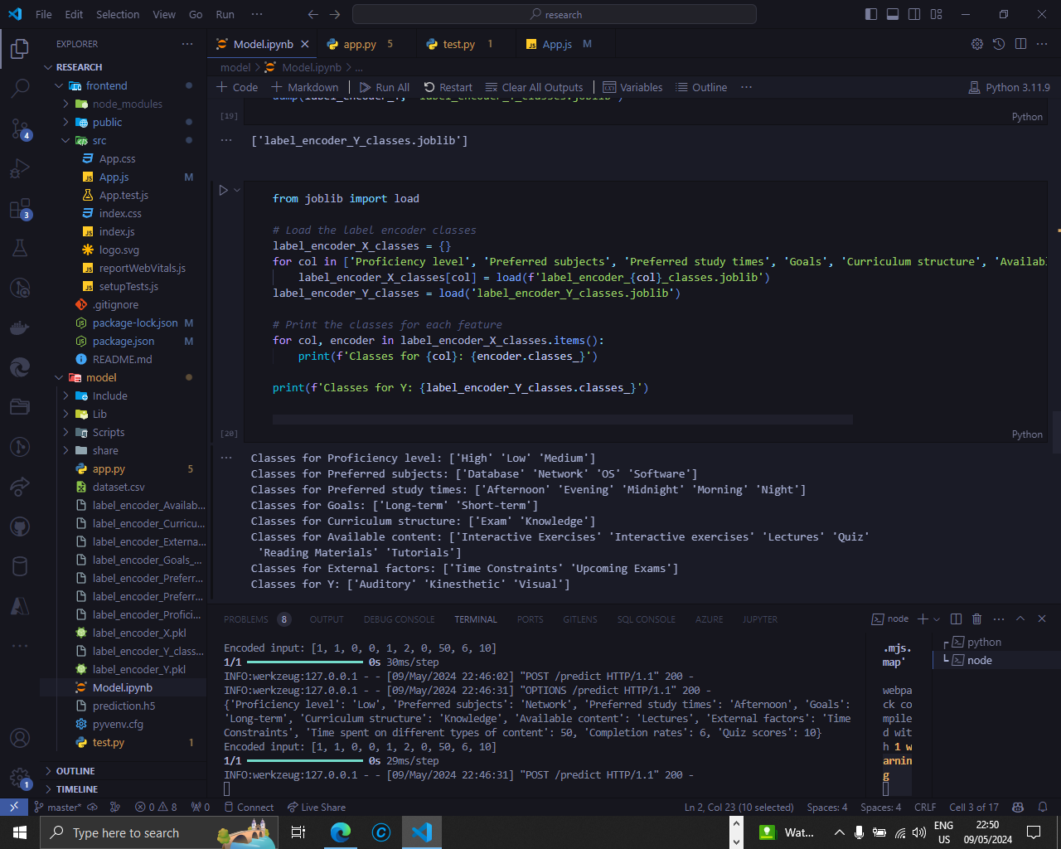
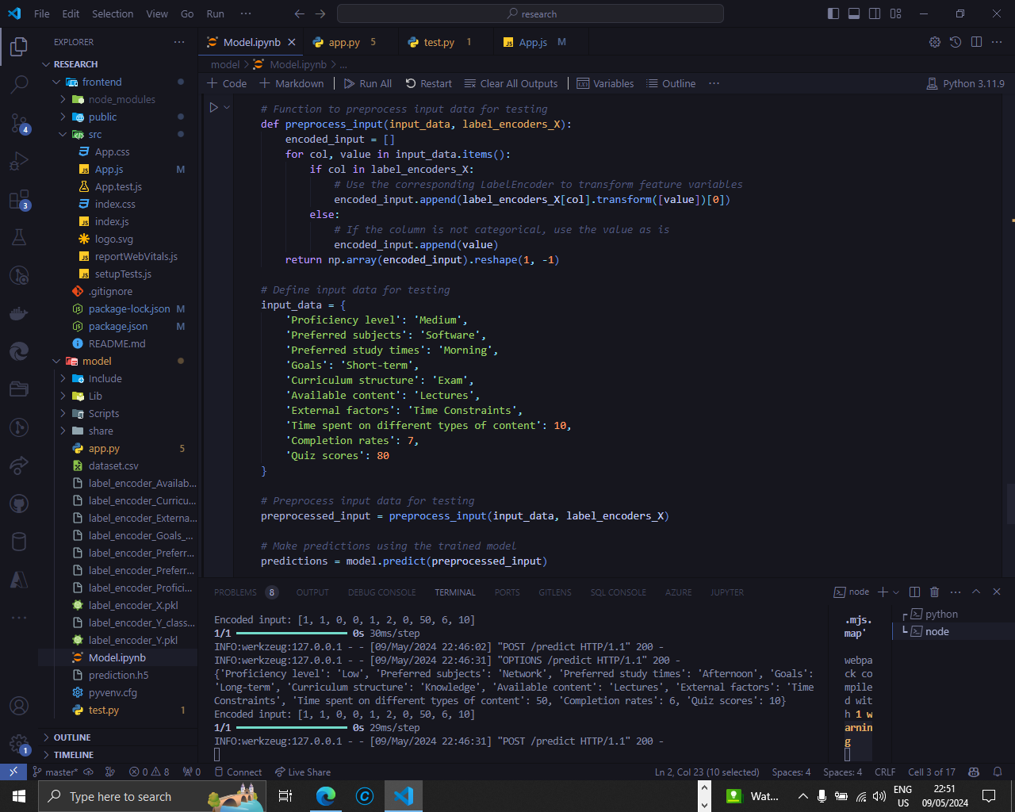
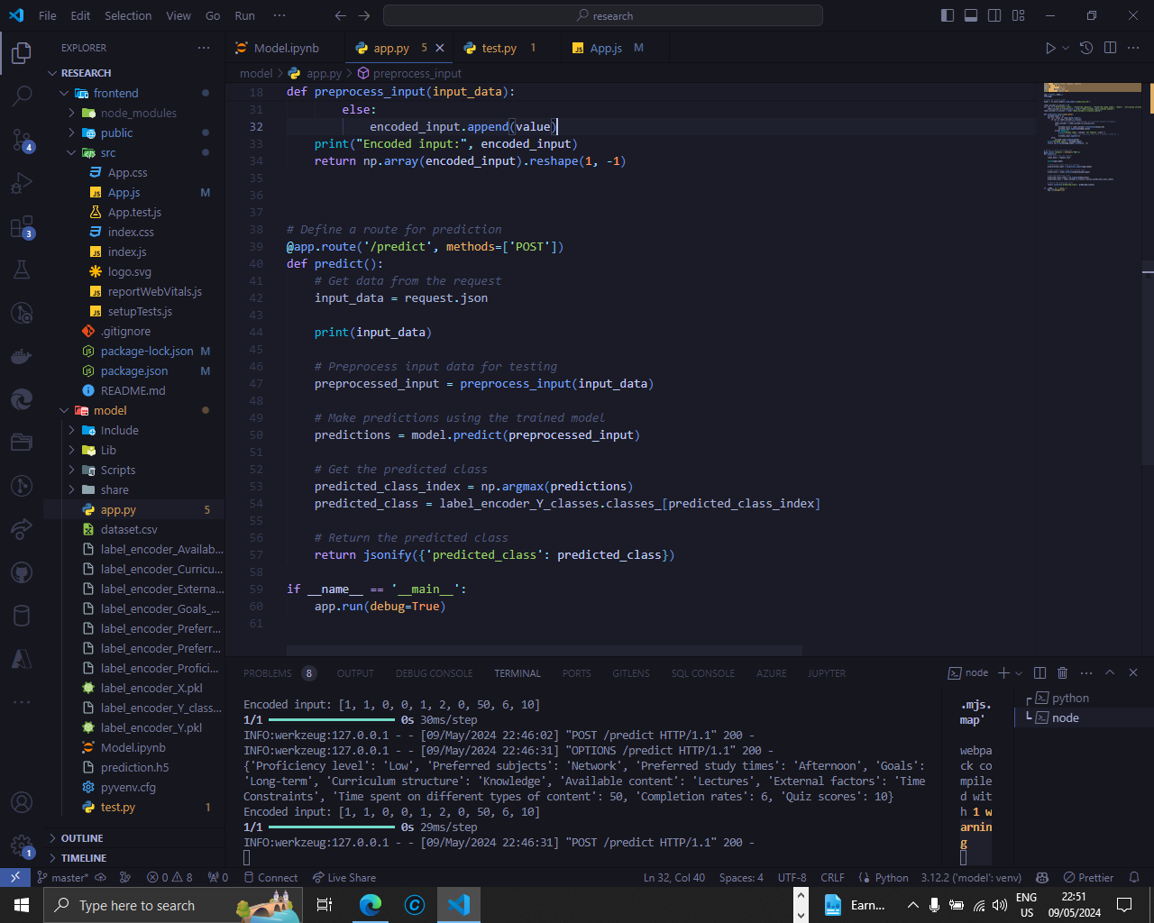
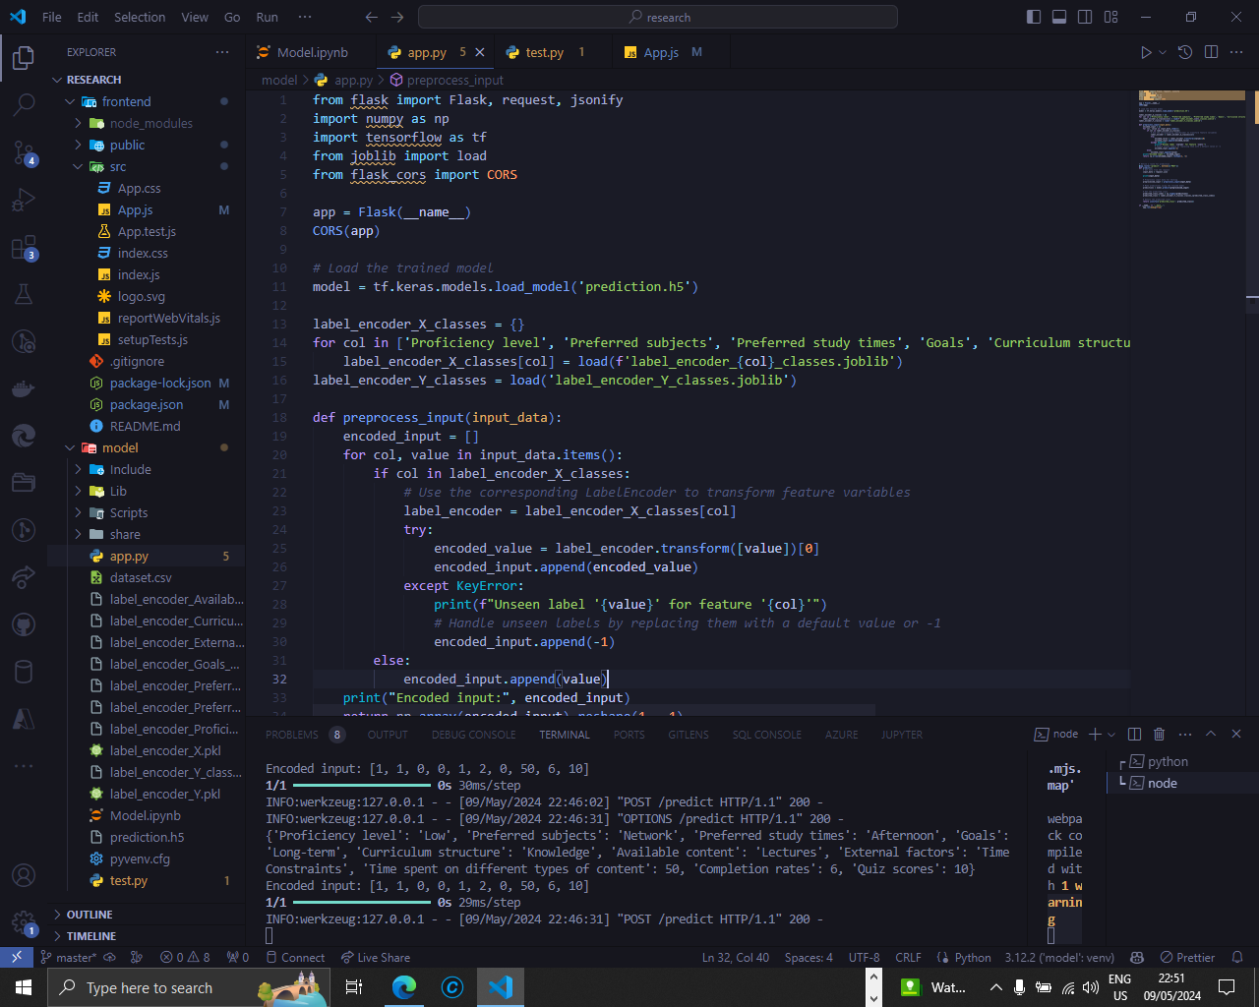
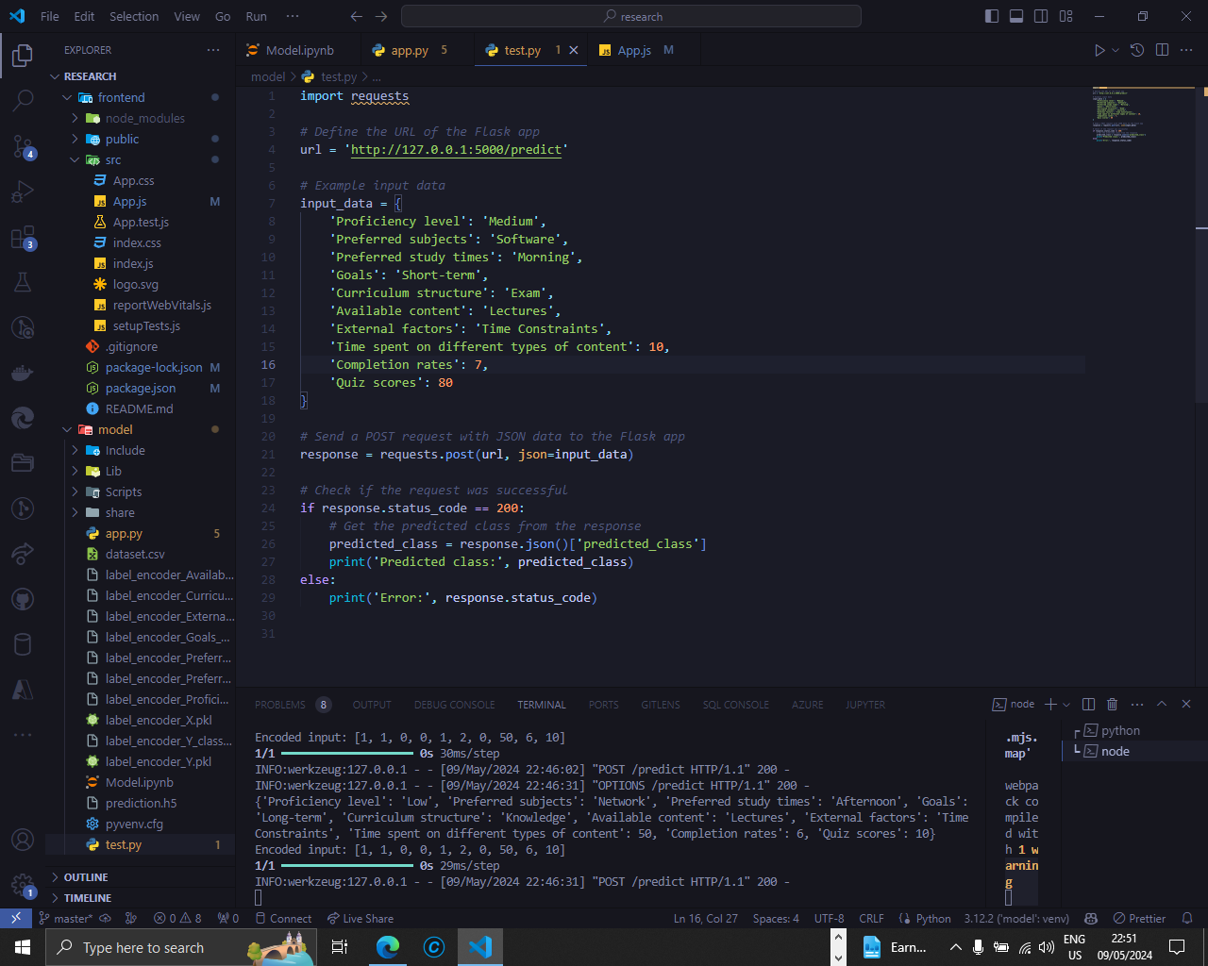
IMPLEMENTATION – PoC
Dynamic Learning pathway generator – Model ( Learning Style )
IT21032806 | Jayasinghe K.A.K.N | R24-112

Slide 52
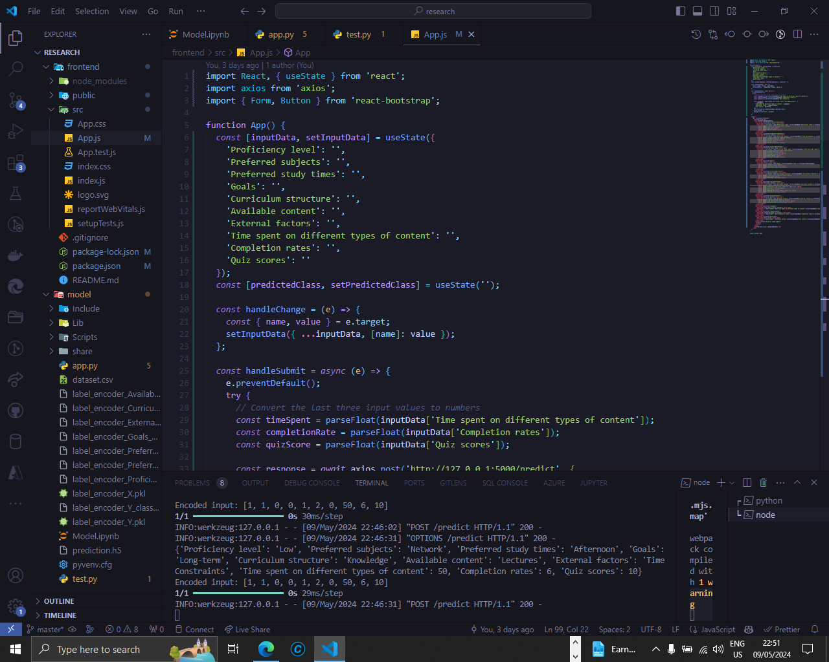
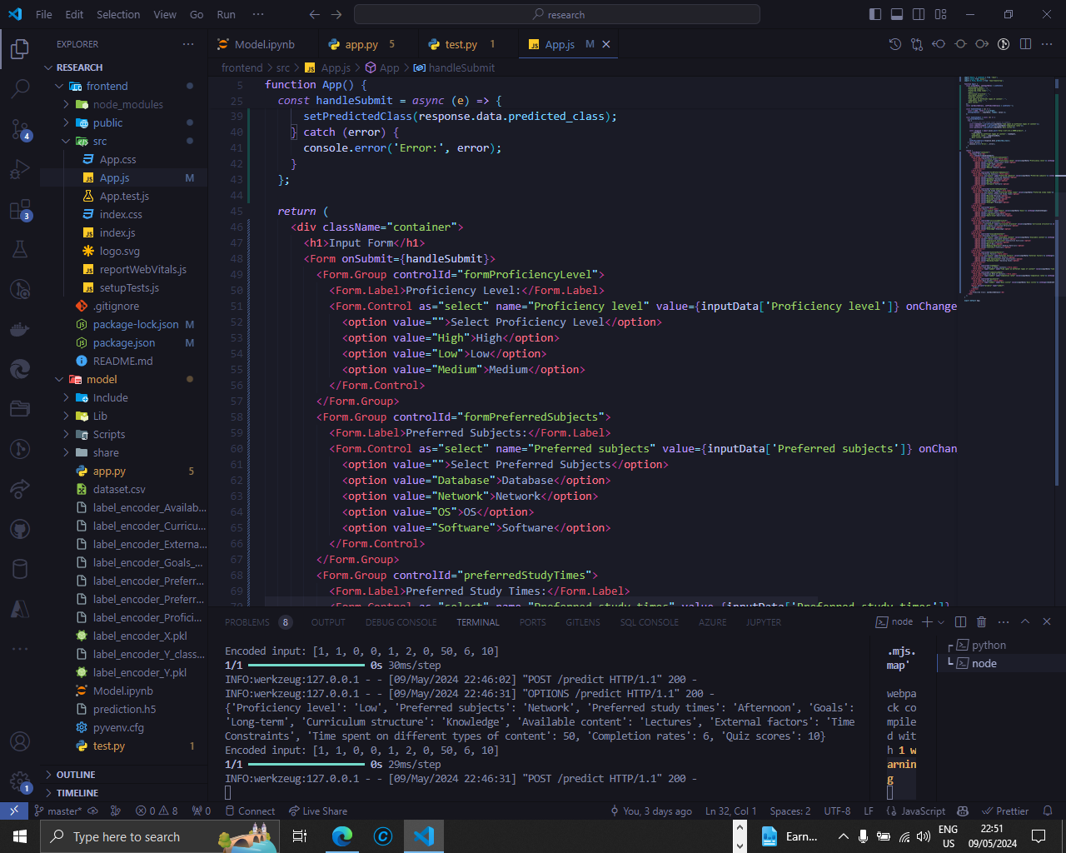
IMPLEMENTATION – PoC
Dynamic Learning pathway generator – Model ( Learning Style ) - FrontEnd
IT21032806 | Jayasinghe K.A.K.N | R24-112

Slide 53
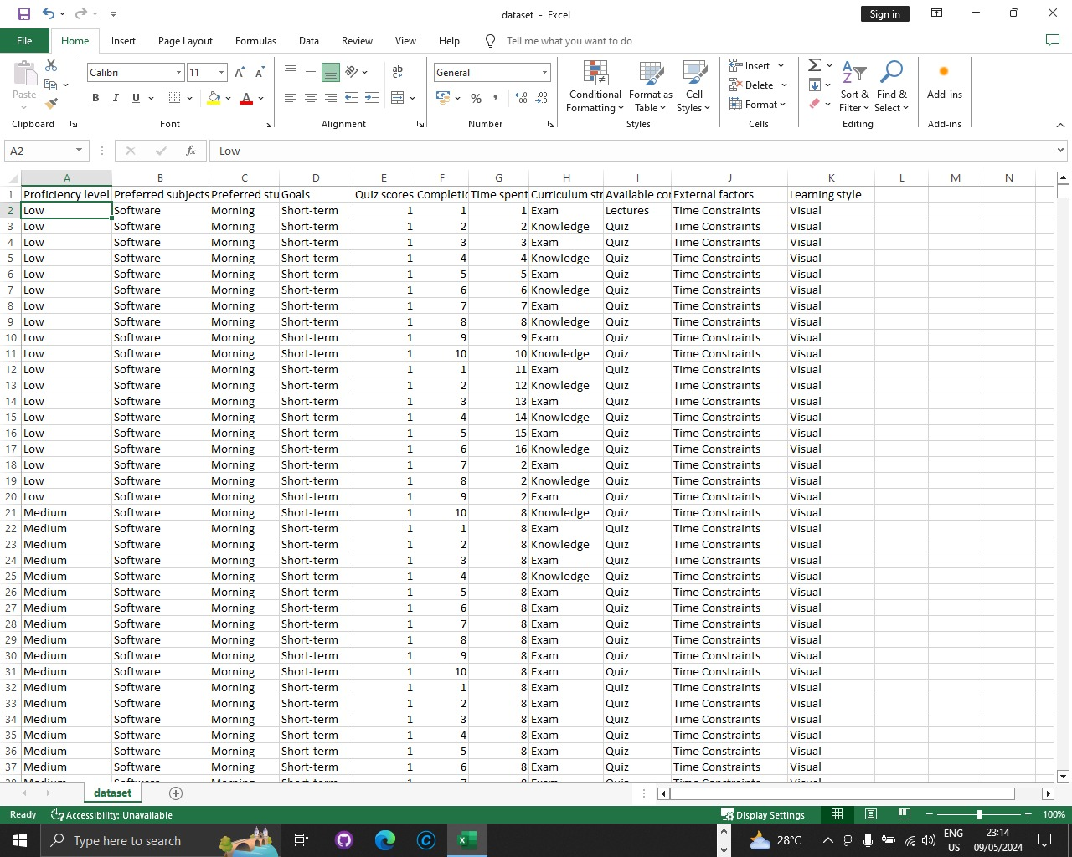
IMPLEMENTATION – PoC
Dynamic Learning pathway generator – Model ( Learning Style ) – Data set
IT21032806 | Jayasinghe K.A.K.N | R24-112

Slide 54
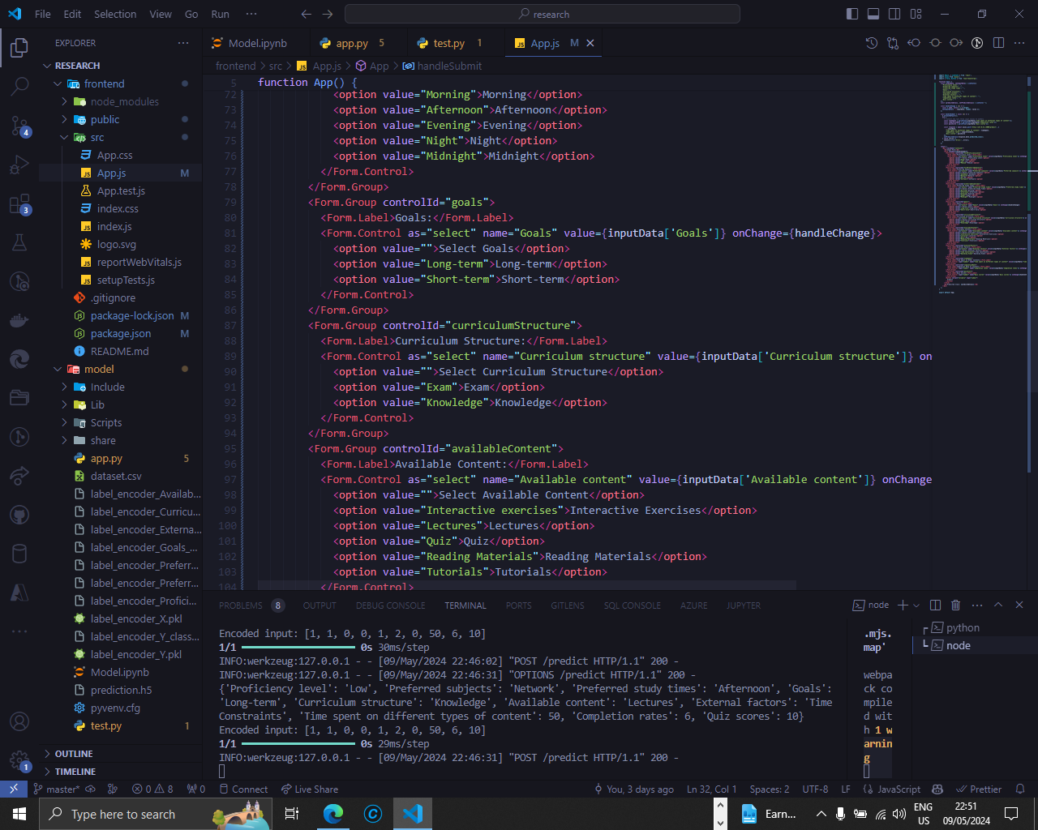
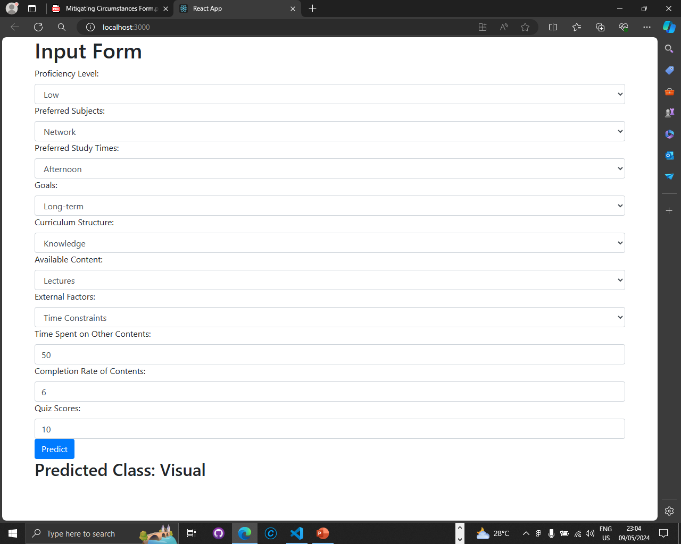
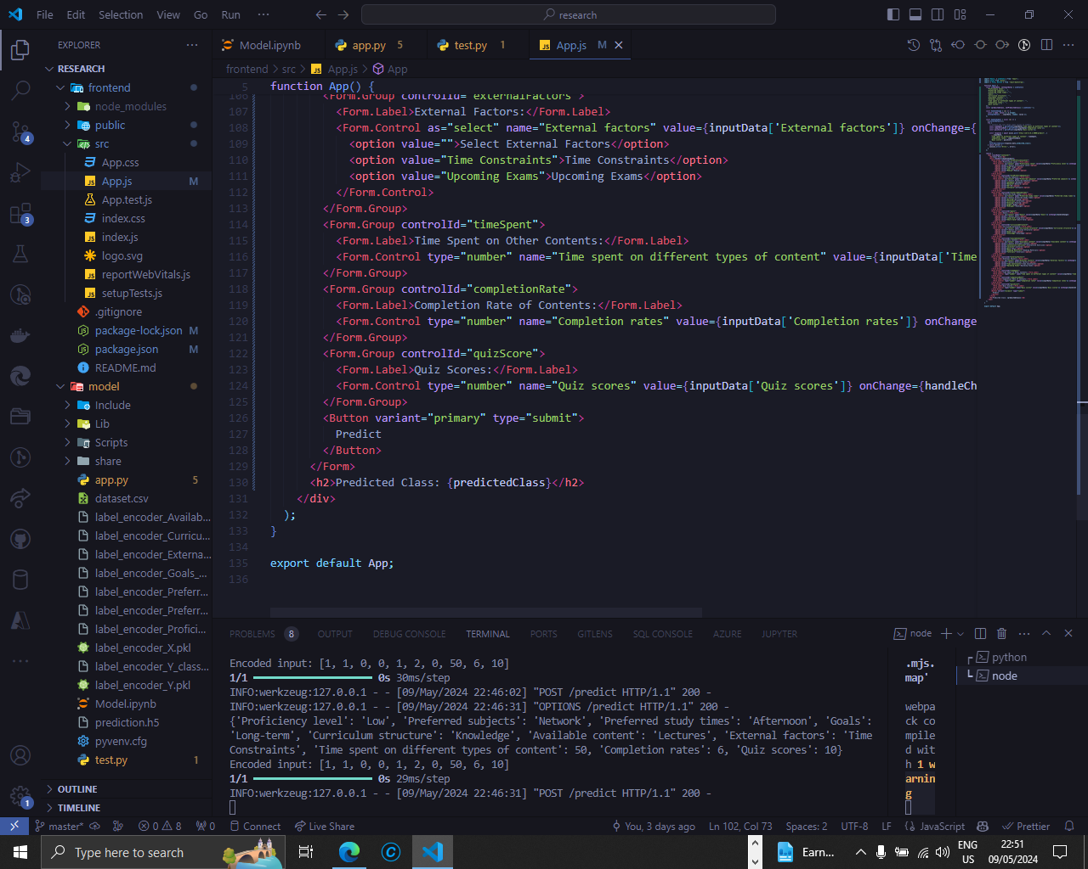
IMPLEMENTATION – PoC
Dynamic Learning pathway generator – Model ( Learning Style ) - FrontEnd
RESULTS
IT21032806 | Jayasinghe K.A.K.N | R24-112

Slide 55
IT21032974 | Nishshanka N.A.G.A.A
Objective : Implementing the dynamic user data gathering module and eye content detection (content focus monitoring), and feedback loop.
Specialization: Information Technology
IT21032974 | Nishshanka N.A.G.A.A | R24-112

Slide 56
INTRODUCTION
IT21032974 | Nishshanka N.A.G.A.A | R24-112

Slide 57
RESEARCH PROBLEM
How effectively can facial expression analysis be utilized to assess user engagement and satisfaction within e-learning environments (content focus monitoring)?
What methodologies can be employed to incorporate non-traditional data, such as eye contact within initial assessments, to assess user attention and inform personalized learning strategies?
How does the incorporation of a feedback loop within engagement analytics influence user satisfaction and perceived learning effectiveness?
IT21032974 | Nishshanka N.A.G.A.A | R24-112

Slide 58
SPECIFIC AND SUB OBJECTIVES
Implement a module for analyze the user eye behavior for predict the user focusing level for learning content and integrate a module for summarize the eye monitoring related data and give the weekly report about student focusing for each subjects.
Implement a feedback loop to get each feedback for each of learning material suggested from the system and Ingenerate OpenAI or Gemini Ai for list down the learning material according to best feedback to bad feedback.
Implement a python module for analysis the feedback loop output and remove learning material from system which get worse feedbacks.
Implementing the MySQL database configuration related to the component.
Implementing the all-relevant frontend pages related to the component.
IT21032974 | Nishshanka N.A.G.A.A | R24-112

Slide 59
COMPLETED TASKS
Complete background research about other LMS platforms and their data usage.
Implement a simple python code for eye detection.
Partially implement a webpages related to the component.
Research terms about the eye detection (technologies, past developments)
Research about OpenAI and Gemini Ai integration for feedback loop.
Identify and finalize the technology stack and backend configurations and database configurations for overall system.
Learn about the relate technologies (system engineering terms) for how to setup this kind of system in real world.
IT21032974 | Nishshanka N.A.G.A.A | R24-112

Slide 60
IN PROGRESS TASKS
Implement a module for analyze the user eye behavior for predict the user focusing level for learning content.
Implement a feedback loop to get each feedback for each of learning material suggested from the system.
Ingenerate OpenAi or Gemeni Ai for list down the learning material according to best feedback to bad feedback.
Implementing the MySQL database configuration related to the user profiling part.
Learn about more technologies and development about eye detection and analysis.
IT21032974 | Nishshanka N.A.G.A.A | R24-112

Slide 61
TASK TO DO
Web Application Design and Implementations
Implement a python module for analysis the feedback loop output and remove learning material from system which get worse feedbacks.
Implement a module for summarize the eye monitoring related data and give the weekly report about student focusing for each subjects.
Learn about more AIML technologies for implement the AIML module.
Integrate all components together.
Conduct a QA process to validate all.
IT21032974 | Nishshanka N.A.G.A.A | R24-112

Slide 62
PROJECT PLANNING
IT21032974 | Nishshanka N.A.G.A.A | R24-112

Slide 63
RESEARCH METHODOLOGY
IT21032974 | Nishshanka N.A.G.A.A | R24-112

Slide 64
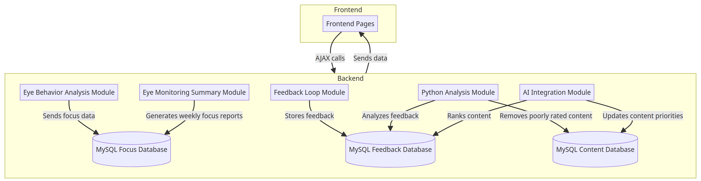
METHODOLOGY - SYSTEM DIAGRAM
Overall System Diagram of Component
IT21032974 | Nishshanka N.A.G.A.A | R24-112
Notes:
Backend:
Eye Behavior Analysis Module: Sends focus data to the MySQL Focus Database.
Feedback Loop Module: Stores user feedback in the MySQL Feedback Database.
Python Analysis Module: Analyzes feedback data and removes poorly rated content from the MySQL Content Database.
AI Integration Module: Ranks content and updates priorities in the MySQL Content Database.
Eye Monitoring Summary Module: Generates weekly reports about student focus and stores data in the MySQL Focus Database.
Frontend:
Frontend Pages: Provides a user interface using HTML, CSS, JavaScript, Tailwind, and PHP.
AJAX calls facilitate communication between the Frontend and Backend components.

Slide 65
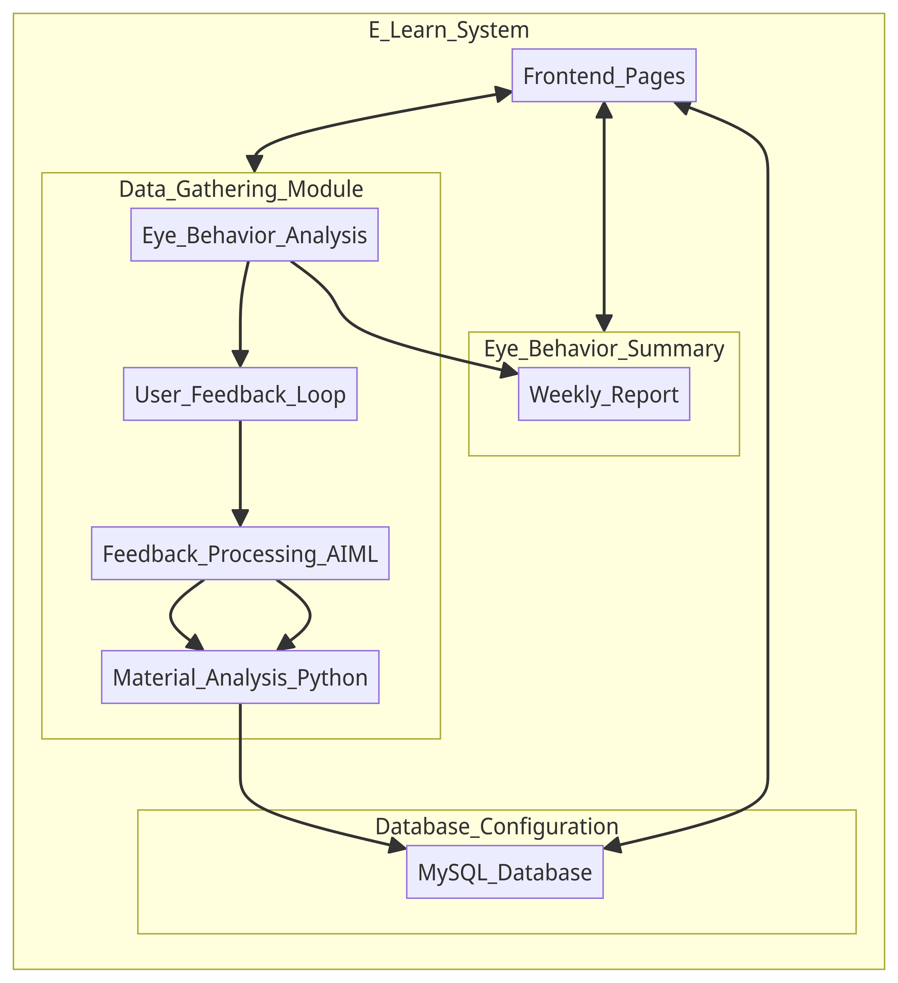
METHODOLOGY - PROCESS DIAGRAM
Overall Process
IT21032974 | Nishshanka N.A.G.A.A | R24-112
Notes:
Eye Behavior Analysis: This module analyzes user eye movement and behavior to assess their focus levels on the learning content.
User Feedback Loop: Collects user feedback on the learning material provided.
Feedback Processing (AIML): Analyzes the gathered feedback using OpenAI or Gemini AI to rank learning materials from best to worst based on user responses.
Material Analysis (Python): Processes the AI-processed feedback, removing learning materials that received predominantly negative feedback.
Eye Behavior Summary (Weekly Report): Summarizes eye-tracking data to generate a weekly report of student focus on each subject.
Database Configuration (MySQL): Configures the MySQL database for all the relevant data storage needs.
Frontend Pages: Represents the necessary frontend web pages required for the module's functionality.

Slide 66
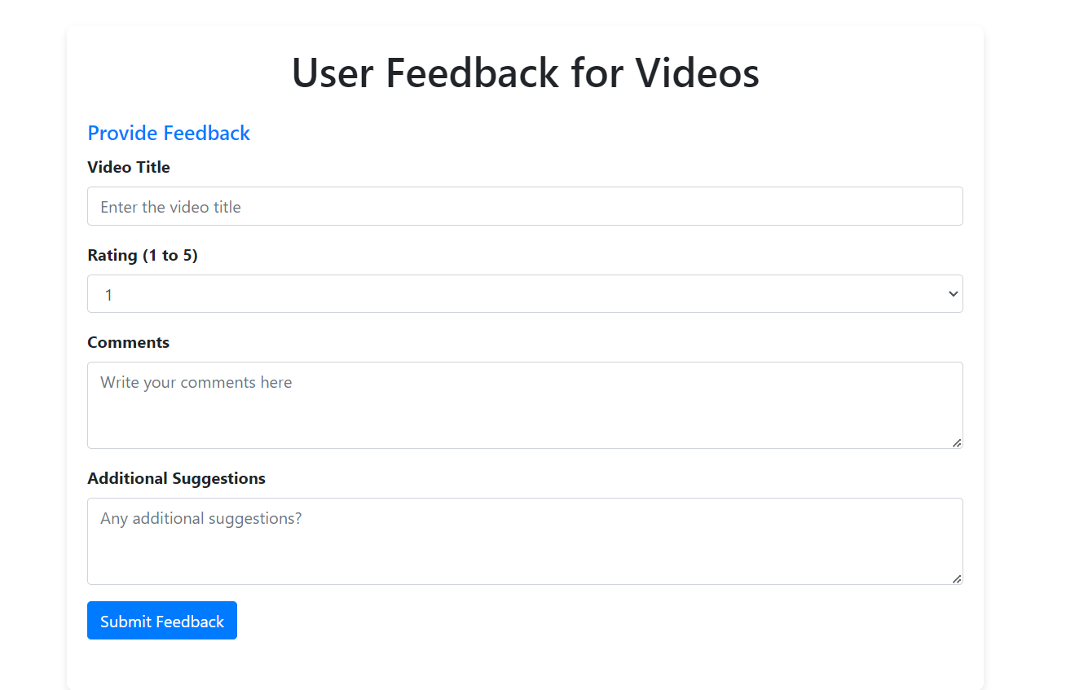
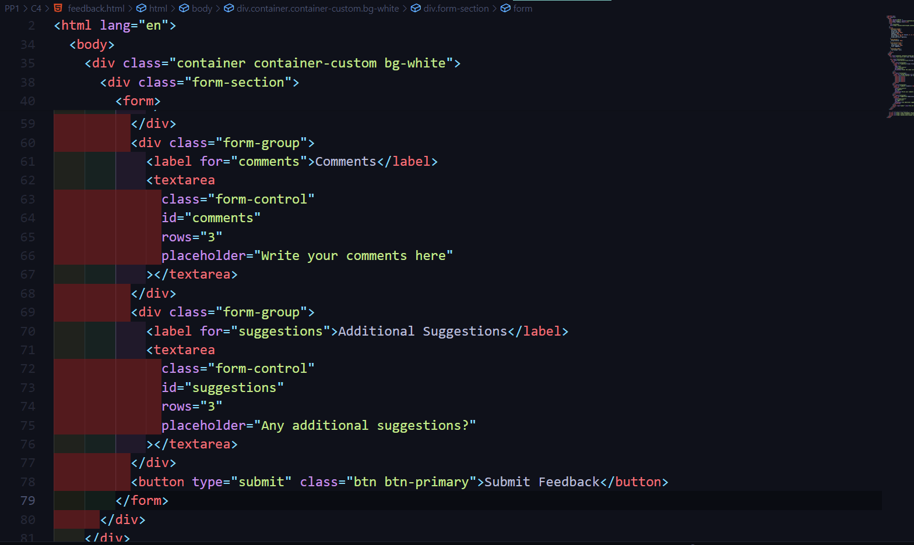
IMPLEMENTATION – PoC
User feedback form
IT21032974 | Nishshanka N.A.G.A.A | R24-112

Slide 67
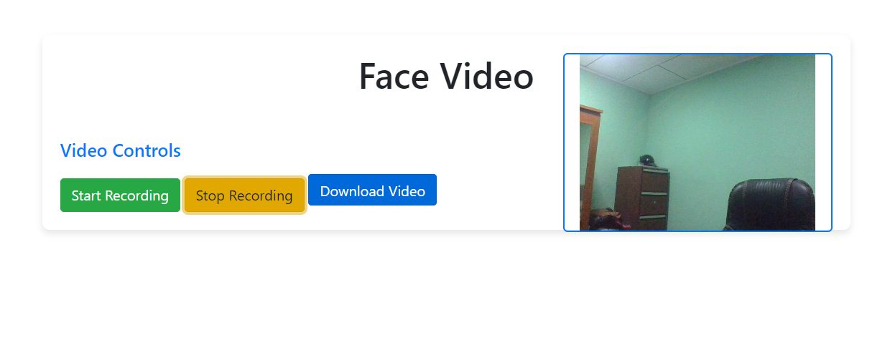

IMPLEMENTATION – PoC
Initial Data gathering form
IT21032974 | Nishshanka N.A.G.A.A | R24-112

Slide 68



IMPLEMENTATION – PoC
Eye detection python code
RESULTS
IT21032974 | Nishshanka N.A.G.A.A | R24-112

Slide 69

COMMERCIALIZATION - OUR PLANS
ONBOARDING
MONTHLY
ANNUALLY
FREE
$99/mo
$999/yr
Only Access limited modules on the LMS
Limited Technical Support
Access limited to only 2 modules modules on the LMS (eye monitor not include)
Limited Technical Support
Unlimited Access to modules on the LMS
Unlimited Technical Support

Slide 70
Thank You

Slide 71


